Slide 1
GIOTRIF® (afatinib) for
Squamous Cell Carcinoma of the Lung
Any external use of materials from the GIOTRIF NSCLC Immersion Slide Deck requires local MLR approval!

Slide 2
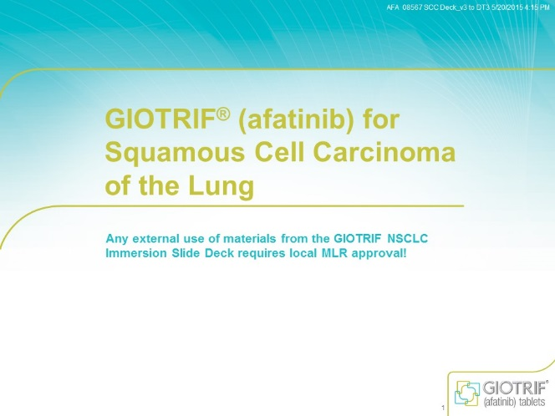
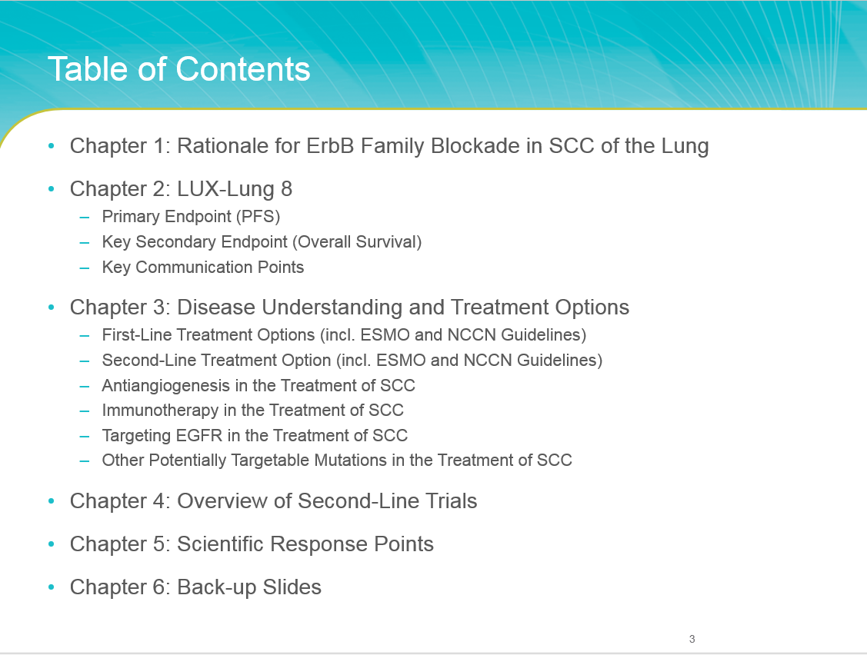
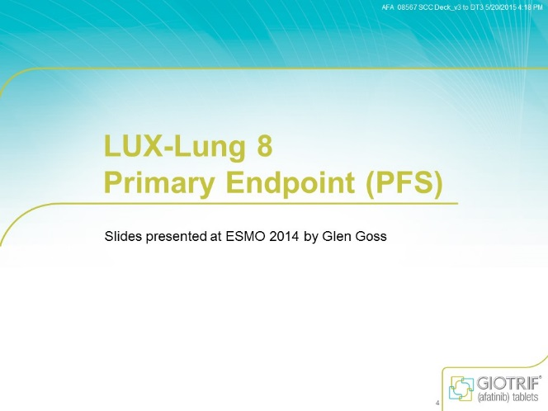
Instructions for Use
To ensure the link functionality of the presentation, view the file in PPT presentation mode
Table of Contents
Once you arrive at the table of contents you may select the chapter you wish to review
Once you click on the desired chapter you will be linked to the first page of that section
Table of Contents
Click on the button in the top left corner to return to the table of contents

Slide 3
Table of Contents
Chapter 1: Rationale for ErbB Family Blockade in SCC of the Lung
Chapter 2: LUX-Lung 8
  Primary Endpoint (PFS)
  Key Secondary Endpoint (Overall Survival)
  Patient Reported Outcomes
Chapter 3: Disease Understanding and Treatment Options
  First-Line Treatment Options (incl. ESMO and NCCN Guidelines)
  Second-Line Treatment Option (incl. ESMO and NCCN Guidelines)
  Antiangiogenesis in the Treatment of SCC of the Lung
  Immunotherapy in the Treatment of SCC of the Lung
  Targeting EGFR in the Treatment of SCC of the Lung
  Other Potentially Targetable Mutations in the Treatment of SCC of the Lung
Chapter 4: Overview of Key Competitors Timelines
Chapter 5: Overview of Trials in Second Line Treatment
Chapter 6: Scientific Response Points
Chapter 7: Back-up Slides

Slide 4
Rationale for ErbB Receptors Blockade in SCC of the Lung

Slide 5
Alterations of ErbB Pathway in SCC of the Lung
EGFR overexpression and/or gene amplification
Aberrations of other ErbB receptors
Dysregulation of downstream pathway
Implicated in the pathobiology of SCC
ErbB Receptor | Frequency (%)
EGFR overexpression | 57-82
EGFR amp | 7-26
EGFRvIII mut | 3-5
EGFR kinase domain mut | 1-3
ERBB2 mut/amp | 4
ERBB3 mut | 1-2
ERBB3 overexpression | 28
ERBB4 | 1-2
1. D’Arcangelo et al. Future Oncol. 2013;9:699; 2. Jaiswal et al. Cancer Cell. 2013;23:603; 3. Kan et al. Nature. 2010;466:869; 4. Hirsch et al. J Clin Oncol. 2003;21:3798; 5. Dacic et al. Am J Clin Pathol. 2006;125:860; 6. Lopez-Malpartida et al. Lung Cancer. 2009;65:25; 7. Lee et al. Lung Cancer. 2010;68:375;
Gately K et al Clin Lung Cancer 2014; 15:58.

Slide 6
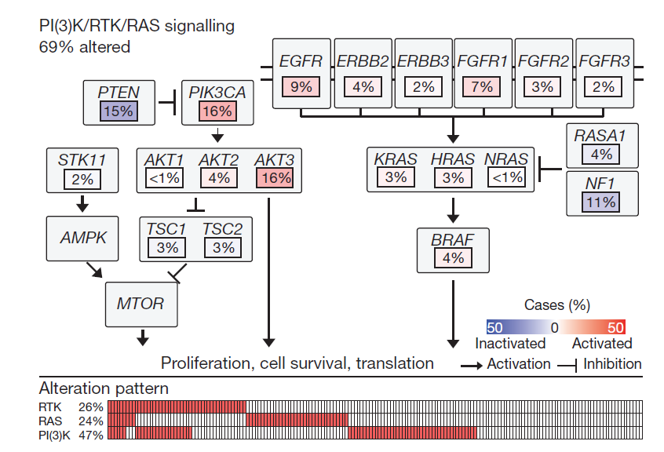
Cancer Genome Atlas Research Network
Alterations in Targetable Oncogenic Pathways in SCC tumors
Analysis of 178 patients with SCC tumours
EGFR mutations in two cases, although these were different from those found in ADC
Alterations in the PI3K/AKT pathway genes were mutually exclusive with EGFR alterations
Cancer Genome Atlas Research Network. Nature. 2012;489:519-25.

Slide 7
Rationale for ErbB Family Inhibition in the Treatment of SCC of the Lung
SCC of the lung is known to have high EGFR overexpression and gene amplification, aberrations of other ErbB receptors, and dysregulation of downstream pathway has been implicated in pathobiology of SCC^{1,2}
These findings likely account for the benefits these patients derive from erlotinib³⁻⁵ and other EGFR-directed therapies in different treatment settings⁶⁻⁸, despite the low frequency of EGFR-activating mutations⁹
Erlotinib is an approved treatment for second-line locally advanced or metastatic NSCLC¹⁰
Afatinib showed anti-tumour activity when investigated in patients with SCC of the lung (ORR=4.4%; DCR=60.4%; LUX-Lung 5)¹¹ and head & neck cancer^{12,13}
1. Hirsch et al. J Clin Oncol. 2003;21:3798; 2. Lopez-Malpartida et al. Lung Cancer. 2009;65:25; 3. Shepherd et al. N Engl J Med. 2005;352:123;
4. Clark et al. Clin Lung Cancer. 2006;7:389; 5. Leon et al. ESMO 2008. 1277P; 6. Pirker et al. Lancet. 2009;373:1525-31;
7. Pirker et al. Lancet Oncol. 2012;13:33; 8. Thatcher et al. ASCO 2014. Abstract 8008; 9. Dearden et al. Ann Oncol. 2013;24:2371;
10. Tarceva Prescribing Information; 11. D’Arcangelo et al. Future Oncol. 2013;9:699; 12. Seiwert et al. Ann Oncol. 2014;25:1813;
13. Machiels et al. Lancet Oncol. 2015;16:583.

Slide 8
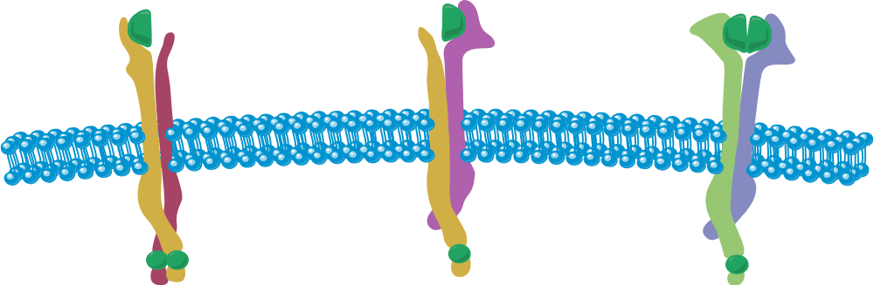
Targeting ErbB Pathway
EGFR/
HER2
HER2/
ErbB3
ErbB3/
ErbB4
Gefitinib
Erlotinib
Afatinib
Afatinib
RAS
P13K
Erlotinib: Reversible EGFR inhibition¹
Afatinib: Irreversible ErbB family blocker²⁻⁴
Inhibits all kinase-active members: EGFR, HER2 and HER4
RAF
AKT
MEK
ERK
mTOR
PROLIFERATION
SURVIVAL
EGFR = epidermal growth factor receptor; HER2 = human epidermal growth factor receptor-2; ; ErbB3 = human epidermal growth factor receptor-3 ErbB4 = human epidermal growth factor receptor-4
1. Schettino et al. Expert Rev Respir Med. 2008;2:167-78; 2. Li D, et al. Oncogene 2008;27:4702–11; 3. Solca F, et al. J Pharmacol Exp Ther 2012;343:342–50; 4. Yarden Y, Pines. G Nat Rev Cancer. 2012;12:553.

Slide 9
LUX-Lung 8
Primary Endpoint (PFS)
Goss et al. ESMO 2014 Abstract 12220

Slide 10
Background
Squamous histology represents approximately 30% of NSCLC^{1,2}
Limited progress and therapeutic options for patients in second-line setting
  Targetable oncogenic alterations are limited and have not yet translated to a therapeutic paradigm
  Patients often have extensive comorbidities
  Erlotinib – last drug approved (in 2005)³
    Based on efficacy vs placebo in second-/third-line setting⁴
    Survival benefit confirmed in subset analysis of male ever-smokers with squamous cell carcinoma⁵
NSCLC = non–small cell lung cancer.
1. Heighway and Betticher. Atlas Genet Cytogenet Oncol Haematol. 2004;8:133.
2. Bryant and Cerfolio. Chest. 2007;132:185.
3. Tarceva EPAR assessment EMA 2007. http://www.ema.europa.eu. Accessed September 5, 2014.
4. Shepherd et al. N Engl J Med. 2005;353:123.
5. Clark et al. Clin Lung Cancer. 2006;7:389.

Slide 11
Afatinib: Irreversible ErbB Family Inhibition
Afatinib is an irreversible ErbB-family blocker^{1,2}
  Inhibits all kinase-active members: EGFR, HER2 and HER4
  Proof of concept in squamous histology in various trials in lung, and head and neck cancer
  Approvedª in the major ICH regions of US,³ EU⁴ and Japan⁵ for the treatment of patients with NSCLC harbouring distinct types of EGFR-activating mutations
EGFR/
HER2
HER2/
ErbB3
ErbB3/
ErbB4
Gefitinib
Erlotinib
Afatinib
Afatinib
RAS
P13K
RAF
AKT
MEK
EGFR = epidermal growth factor receptor; HER2 = human epidermal growth factor receptor-2; HER4 = human epidermal growth factor receptor-4; ICH = International Conference on Harmonisation of Technical Requirements for Registration of Pharmaceuticals for Human Use.
ªIndications differ between countries.
1. Li et al. Oncogene. 2008;27:4702.
2. Solca et al. J Pharmacol Exp Ther. 2012;343:342.
3. Gilotrif Prescribing Information 2013.
4. Giotrif EPAR Assessment EMA 2013.
5. PMDA Japan New Drug Approvals 2013.
ERK
mTOR
PROLIFERATION
SURVIVAL

Slide 12
LUX-Lung 8: Study Design
Advanced NSCLC
(Stage IIIB/IV)ª
Squamous histology^{b}
≥4 cycles of a first-line platinum doublet^{c}
ECOG PS 0–1
Adequate organ function
Afatinib
40 mg QD^{d}
Treatment
until disease
progression
or
unacceptable
AEs
Randomisation 1:1
Erlotinib
150 mg qd
Excluded:
Patients without PD
Prior EGFR TKI or antibody
Active brain metastases, Interstitial lung disease
        Stratification: East Asian vs non-East Asian
        Tumour tissue collected for correlative science
        Radiographic tumour assessment at baseline, weeks 8, 12, 16; every 8 weeks thereafter
ªAmerican Joint Committee on Cancer Staging Manual, 7th edition.
^{b}As determined by the investigator, tumours with mixed histology allowed.
^{c}Patients progressing within 6 months of receiving adjuvant/neoadjuvant chemo/chemoradiotherapy were allowed (as long as ≥4 cycles criterion was met).
^{d}Dose escalation to 50 mg at cycle 2 for patients meeting adverse event criteria.
ECOG = Eastern Cooperative Oncology Group; PS = performance status; AE = adverse events;
PD = progressive disease; TKI = tyrosine kinase inhibitor.
Goss et al. ESMO 2014. Abstract 12220.

Slide 13
Endpoints
Primary endpoint – Progression-free survival by central independent radiology review (RECIST 1.1)
Key secondary endpoint – Overall survival
Secondary endpoints
  Objective response rate
  Disease control rate
  Tumour shrinkage
  Health-related quality of life
  Safety in both treatment groups
RECIST = Response Evaluation Criteria in Solid Tumours.
Goss et al. ESMO 2014. Abstract 12220.

Slide 14
Timelines and Interim Futility Analysis
Recruitment
    Mar 12 Mar 13 Oct 13 Jan 14 Dec 14
First patient in
Interim analysis
PFS analysis
Last patient in
OS analysisª
An interim futility analysis was performed by an independent DMC and the trial was allowed to accrue to the planned 800 patients
The PFS primary analysis was conducted when trial recruitment was ongoing
DMC = data monitoring committee; OS = overall survival; PFS = progression-free survival.
ªEvent-dependent.
Goss et al. ESMO 2014. Abstract 12220.

Slide 15
Statistical Assumptions
Primary endpoint – PFS by Independent Radiology Review
(RECIST 1.1)
  Assuming a median PFS of 14 weeks in the afatinib arm and 10 weeks in the erlotinib arm, ≥372 events and a sample size of 500 were required for 90% power to detect a hazard ratio of 0.714 using a two-sided level test
Key secondary endpoint – OS to be tested only if PFS showed statistical significance (P<0.05, two-sided)
  A median OS of 8.75 months with afatinib and 7 months with erlotinib required ≥632 events and a sample size of 800 for 80% power to detect a hazard ratio of 0.8 (two-sided)
Goss et al. ESMO 2014. Abstract 12220.

Slide 16
LUX-Lung 8: Global Randomised Phase 3 Trial
Goss et al. ESMO 2014. Abstract 12220.

Slide 17
Primary PFS Analysis
Assessed for eligibility (n=835)
Ineligible/not treated
(n=166)
Randomised
(n=669)
Afatinib
(n=335)
Erlotinib
(n=334)
Treated
(n=329)
Treated
(n=332)
Remaining on treatment (n=70)
Remaining on treatment (n=69)
Goss et al. ESMO 2014. Abstract 12220.

Slide 18
Demographics and Baseline Characteristics
 |  | Afatinib^{g} | Erlotinib^{g} | Total
Number randomised |  | 335 | 334 | 669
ECOGª, % | 0 | 33 | 35 | 34
 | 1 | 66 | 65 | 66
Male, % |  | 85 | 84 | 85
Race (for stratification), % | Non-East Asian | 78 | 78 | 78
 | East Asian | 22 | 23 | 22
Median age, years |  | 65 | 64 | 65
Smoking history, % | Never smoker | 8 | 3 | 5
 | Ex-smoker^{e} | 7 | 6 | 7
 | Smoker | 85 | 91 | 88
Median time since diagnosis, years |  | 0.7 | 0.8 | 0.8
Clinical stage^{b}, % | IIIB | 13 | 12 | 12
 | IV | 88 | 87 | 87
Histology^{c}, % | Squamous | 96 | 96 | 96
 | Mixed type^{f} | 5 | 3 | 4
Prior chemotherapy, % | Platinum-doublet | 100 | 100 | 100
Best response to first-line chemotherapy^{d}, % | CR/PR | 47 | 46 | 46
 | SD | 41 | 43 | 42
 | Unknown | 13 | 11 | 12
CR = complete response; PR = partial response; SD = stable disease. ª<1% were ECOG PS 2; ^{b}<1% were stage IIIA; ^{c}<1% were undifferentiated (considered to be of squamous histology); ^{d}<1% had PD; ^{e}<15 pack years and stopped >1 year before diagnosis; ^{f}considered to be of squamous histology; ^{g}percentages may not total 100 due to rounding.
Goss et al. ESMO 2014. Abstract 12220.

Slide 19
LUX-Lung 8: PFS (Independent Review)
1.0
 | Afatinib (n=335) | Erlotinib (n=334)
Patients progressed or died, n (%) | 202 (60) | 212 (64)
Median PFS (months) | 2.4 | 1.9
HR (95% CI) P value | 0.822 (0.676-0.998) P=0.0427
0.8
0.6
Estimated PFS Probability
0.4
Afatinib
0.2
Erlotinib
0
0
1
2
3
4
5
6
7
8
9
10
11
12
13
14
15
Months
No. of patients
Afatinib 335 266 127 96 54 45 28 25 16 15 8 8 4 2 2 1
Erlotinib 334 256 112 72 43 34 15 12 6 5 0 0 0 0 0 0
CI = confidence interval; HR = hazard ratio.
Goss et al. ESMO 2014. Abstract 12220.

Slide 20
LUX-Lung 8: PFS (Investigator Review)
1.0
 | Afatinib (n=335) | Erlotinib (n=334)
Patients progressed or died, n (%) | 228 (68) | 242 (72)
Median PFS (months) | 2.7 | 1.9
HR (95% CI) P value | 0.78 (0.65-0.93) P=0.0053
0.8
0.6
Estimated PFS Probability
0.4
Afatinib
0.2
Erlotinib
0
0
1
2
3
4
5
6
7
8
9
10
11
12
13
14
15
Months
No. of patients
Afatinib 335 260 137 110 66 56 30 28 19 17 12 9 5 1 1 0
Erlotinib 334 252 119 78 49 40 18 15 9 8 2 1 0 0 0 0
Goss et al. ESMO 2014. Abstract 12220.

Slide 21
PFS Subgroups: Independent Review
Factors
Number of Patients
Hazard Ratio (95% CI)
Overall |  | 669 |  | 0.82 (0.68–1.00)
Race | Non-East Asian | 520 |  | 0.89 (0.72–1.11)
 | East Asian | 149 |  | 0.59 (0.38–0.92)
Gender | Male | 566 |  | 0.87 (0.70–1.07)
 | Female | 103 |  | 0.57 (0.34–0.95)
Best response to first-line chemotherapy | CR/PR | 310 |  | 0.84 (0.63–1.11)
 | SD | 279 |  | 0.89 (0.66–1.21)
 | Unknown | 79 |  | 0.55 (0.31–0.96)
Histology | Squamous | 642 |  | 0.81 (0.66–0.98)
 | Mixed | 27 |  | 0.89 (0.31–2.57)
Smoking history | Never smoker | 35 |  | 0.45 (0.19–1.05)
 | Ex-smokerª | 44 |  | 0.44 (0.19–1.05)
 | Smoker | 590 |  | 0.87 (0.71–1.07)
ECOG at baseline | 0 | 228 |  | 0.73 (0.52–1.02)
 | 1 | 438 |  | 0.85 (0.67–1.08)
Age | <65 years | 332 |  | 0.83 (0.63–1.08)
 | ≥65 years | 337 |  | 0.79 (0.60–1.05)
1/16
1/4
1
4
16
Favours Afatinib
Favours Erlotinib
ª<15 pack years and stopped >1 year before diagnosis.
Goss et al. ESMO 2014. Abstract 12220.

Slide 22
Tumour Shrinkage
Afatinib
Erlotinib
100
100
80
80
60
60
40
40
20
20
Maximum % Decrease From Baseline SLD
Maximum % Decrease From Baseline SLD
0
0
–20
–20
–40
–40
–60
–60
–80
–80
–100
–100
Sorted patient index
Sorted patient index
≥20% increase
0 – <20% increase
>0 – <30% decrease
≥30% decrease
SLD = sum of target lesion diameters.
Goss et al. ESMO 2014. Abstract 12220.

Slide 23
LUX-Lung 8:
Objective Response (Independent Review)
ª
Afatinib
Erlotinib
50
12
40
10
8
30
Percent
Months
6
20
4
10
^{b}
2
0
0
Disease control rate
OR
PD
Duration
of OR
ªOdds ratio: 1.44; 95% CI, 1.06–1.96; P value 0.0203.
^{b}Odds ratio: 1.63; 95% CI, 0.73–3.66; P value 0.2332.
Goss et al. ESMO 2014. Abstract 12220.

Slide 24
LUX-Lung 8: Adverse Events Overall Summary
 | Afatinib (n=329) (%) | Erlotinib (n=332) (%)
Any AE | 98 | 96
Drug-related AEs | 91 | 80
CTCAE grade 3 or higher | 50 | 49
AEs leading to dose reduction | 24 | 12
AEs leading to discontinuations excluding PD-related | 15 | 12
SAEs | 39 | 38
Fatal (all cause, excluding PD) | 12 | 11
CTCAE = Common Terminology Criteria for Adverse Events; SAEs = serious adverse events.
Goss et al. ESMO 2014. Abstract 12220.

Slide 25
LUX-Lung 8: Drug-Related AEs (>5%)
Grouped categories by CTCAE grades
 | Afatinib (N=329) n, (%) |  |  |  | Erlotinib (N=332) n, (%)
AE Category | All | Grade 3 | Grade 4^{d} |  | All | Grade 3 | Grade 4e
Total with related AEs | 298 (91) | 75 (23) | 4 (1) |  | 266 (80) | 48 (15) | 1 (<1)
Diarrhoea | 218 (66) | 30 (9) | 2 (<1) |  | 103 (31) | 7 (2) | 1 (<1)
Rash/acneª | 208 (63) | 18 (6) |  |  | 221 (67) | 30 (9)
Stomatitisª | 90 (27) | 11 (3) |  |  | 28 (8)
Fatigueª | 44 (13) | 3 (1) |  |  | 43 (13) | 6 (2)
Decreased appetite | 38 (12) | 3 (1) |  |  | 34 (10) | 2 (<1)
Nausea | 38 (12) | 3 (1) |  |  | 24 (7) | 3 (1)
Paronychiaª | 35 (11) | 1 (<1) |  |  | 14 (4) | 1 (<1)
Pruritus | 29 (9) | 1 (<1) |  |  | 36 (11)
Dry skin | 27 (8)^{b} | 2 (<1) |  |  | 34 (10)
Vomiting | 25 (8)^{c} | 2 (<1) |  |  | 10 (3) | 2 (<1)
ªGrouped terms; ^{b}8.2; ^{c}7.6; ^{d}Six patients (1.8%) in the afatinib treatment group had drug-related fatal AEs: interstitial lung disease (2 patients) and pneumonia, respiratory failure, acute renal failure, and general physical health deterioration
(1 patient each); ^{e}Two patients (0.6%) in the erlotinib treatment group had drug-related fatal AEs: intersitial lung disease and peritonitis (1 patient each).
Goss et al. ESMO 2014. Abstract 12220.

Slide 26
LUX-Lung 8: Patient-Reported Outcomesª
Percent of Patients Improved^{b}
60
P=0.298
Afatinib
Erlotinib
50
P=0.01
P=1.0
P=0.026
40
30
Patients Improved (%)^{b}
20
10
0
Coughing
(Q1, QLQ-LC13)
Dyspnoea
(Q3-5, QLQ-LC13)
Pain
(Q9, Q19, QLQ-C30)
Global Health Status/QOL
(Q29-30, QLQ-C30)
ªFurther PRO data will be presented at a later date.
^{b}Based on EORTC QLQ-C30 and QLQ-LC13.
PRO = patient-reported outcomes; EORTC = European Organisation for Research and Treatment of Cancer; QLQ-Q30 = Core Quality of Life Questionnaire; LC13 = Lung Cancer Module; QoL = quality of life.
Goss et al. ESMO 2014. Abstract 12220.

Slide 27
LUX-Lung 8: Patient-Reported Outcomesª (cont’d)
Time to deterioration of lung cancer symptoms and quality of life^{b}
No. of Patients
HR (95% CI)
Coughing (Q1, QLQ-LC13)
Dyspnoea (Q3-5, QLQ-LC13)
Pain (Q9, Q19, QLQ-C30)
Global health status/QoL (Q29-30, QLQ-C30)
Physical functioning (Q1-5, QLQ-C30)
Role functioning (Q6-7, QLQ-C30)
Cognitive functioning (Q20, Q25, QLQ-C30)
Emotional functioning (Q21-24, QLQ-C30)
Social functioning (Q26-27, QLQ-C30)
666
666
666
666
666
666
666
666
666
0.87 (0.68-1.12)
0.82 (0.66-1.01)
0.99 (0.80-1.23)
0.91 (0.73-1.13)
0.81 (0.64-1.02)
0.83 (0.67-1.03)
0.95 (0.76-1.19)
0.88 (0.70-1.12)
1.02 (0.82-1.27)
1/4
1/2
1
2
4
Favours Afatinib
Favours Erlotinib
ªFurther PRO data will be presented at a later date.
^{b}Based on EORTC QLQ-C30 and QLQ-LC13.
Goss et al. ESMO 2014. Abstract 12220.

Slide 28
LUX-Lung 8: Conclusions
Afatinib significantly improved PFS when compared with erlotinib
  Independent and investigator reviews were consistent
Tumour shrinkage was greater, response rate higher, and disease control rate significantly higher in the afatinib arm compared with the erlotinib arm
Overall AE profile was consistent with mechanistic profile and was manageable
  Rate of SAEs and grade ≥3 AEs similar for both drugs
Patient-reported outcomes favoured afatinib vs erlotinib
OS data are awaited
Goss et al. ESMO 2014. Abstract 12220.

Slide 29
LUX-Lung 8
Key Secondary Endpoint (Overall Survival)
Soria et al. ASCO 2015 Abstract 8002

Slide 30
Background
SCC of the lung remains a disease with high unmet medical need
ErbB pathway dysregulation is frequently observed in SCC¹⁻³
Erlotinib, a reversible EGFR TKI, is an approved second-line therapy for these patients
  Improved tolerability over docetaxel⁴ yet similar survival in second-line unselected and EGFRwt NSCLC⁵
Afatinib could confer additional benefit over erlotinib
  Irreversible inhibition of signaling from ErbB1(EGFR), HER2 to HER4⁶
1. Heinmoller et al. Clin Cancer Res. 2003;9:5238; 2. Ugocsai et al. Anticancer Res. 2005;25:3061; 3. Cancer Genome Atlas Research Network. Nature. 2012;489:519; 4. Lee et al. J Natl Cancer Inst. 2013;105:595; 5. Li et al. PLoS One. 2014;9(7):e102777; 6. Solca et al. J Pharmacol Exp Ther. 2012;343:342.

Slide 31
Study Design
SCC of the lung (stage IIIB/IV)
Progressed after
≥4 cycles of a
first-line
platinum doublet
ECOG PS 0–1
Adequate organ function
Stratified by East Asian vs
non-east Asian
Key secondary
endpoint
OS
Other secondary
endpoints:
ORR, DCR,
tumour shrinkage,
PRO, safety
Afatinib
40 mgª QD
Primary
endpoint
PFS by
independent
review^{c}
1:1
Erlotinib
150 mg^{b} QD
ªDose escalation to 50 mg and dose reduction to 30 or 20 mg permitted.
^{b}Dose reduction to 100 or 50 mg permitted.
^{c}Tumour assessment at baseline and weeks 8, 12, and 16; every 8 weeks thereafter.

Slide 32
Timelines
Follow-up
Recruitment
Mar 2012
Oct 2013
n=669
Jan 2014
n=795
Mar 2015
Primary PFS analysis
ESMO 2014¹
Primary OS analysis
Updated PFS, ORR, DCR, PRO, safety
1. Goss et al. ESMO 2014. Abstract 12220.

Slide 33
Statistical Assumptions
Primary endpoint: PFS by independent radiology review (RECIST version 1.1)
  Required ≥372 PFS events (90% power; HR=0.714ª; median PFS 10 vs 14 weeks)
  endpoint was met: afatinib significantly improved PFS; HR=0.82; 95% CI, 0.68-1.00; P=0.0427; median 2.4 vs 1.9 months¹
Key secondary endpoint: OS
  Required 632 death events (80% power to detect HR of 0.80ª)
    Increase in median OS from 7.0 to 8.75 months
ªTwo-sided 5% significance level.
1. Goss et al. ESMO 2014. Abstract 12220.

Slide 34
Recruitment

Slide 35
Patient Disposition
Assessed for eligibility (n=977)
Did not meet entry
criteria or did not enter
(n=182)
Randomised (n=795)
Afatinib (n=398)
Erlotinib (n=397)
392 treated
395 treated
307 died
325 died
6 still on treatment
3 still on treatment
Soria et al. ASCO 2015. Abstract 8002

Slide 36
Demographics and Baseline Characteristics
 |  | Afatinib^{g} (n=398) | Erlotinib^{g} (n=397)
Median age, years |  | 65 | 64
Male, % |  | 84 | 83
Race, % | Asian | 24 | 24
 | East Asian | 22 | 22
 | White | 72 | 73
 | Other^{d} | 2 | 3
Smoking history, % | Never smoker | 7 | 5
 | Light ex-smoker^{e} | 3 | 3
 | Current and other ex-smoker^{f} | 91 | 92
ECOG,ª % | 0/1 | 32/68 | 34/66
Clinical stage,^{b} % | IIIB/IV | 12/88 | 12/87
Histology,^{c} % | Squamous | 96 | 96
 | Mixed | 4 | 4
Best response to first-line chemotherapy, % | CR/PR | 47 | 47
 | SD | 41 | 42
 | Unknown | 12 | 11
ª<1% were ECOG PS 2; ^{b}≤1% were stage IIIA; ^{c}<1% were undifferentiated (considered to be of squamous histology); ^{d}Includes black/African American and American Indian/Alaska Native; ^{e}Fifteen pack-years and stopped >1 year before diagnosis; ^{f}Seventy-one (17.8%) and 85 (21.4%) patients were current smokers, respectively; ^{g}Percentages may not total 100 due to rounding.
Soria et al. ASCO 2015. Abstract 8002

Slide 37
Primary Analysis of OS (n=795)
1.0
 | Afatinib (n=398) | Erlotinib (n=397)
Median OS, months (95% CI) | 7.9 (7.2-8.7) | 6.8 (5.9-7.8)
HR (95% CI) | 0.81 (0.69-0.95)
P value | 0.0077
0.9
0.8
0.7
0.6
Estimated OS Probability
0.5
36.4%
0.4
0.3
22.0%
28.2%
0.2
0.1
14.4%
0
0
3
6
9
12
15
18
21
24
27
30
No. at risk
Months
Afatinib
316
170
124
82
47
28
10
4
398
249
0
Erlotinib
397
305
210
150
94
54
30
11
4
2
0
Median follow-up time: 18.4 months.
Soria et al. ASCO 2015. Abstract 8002

Slide 38
OS Subgroup Analysis
Factors | No. of Patients |  | Hazard Ratio (95% CI)
Overall | 795 |  | 0.81 (0.69–0.95)
Age
<65 years | 399 |  | 0.68 (0.55–0.85)
≥65 years | 396 |  | 0.95 (0.76–1.19)
Gender
Male | 666 |  | 0.82 (0.69–0.97)
Female | 129 |  | 0.77 (0.51–1.14)
Race
Non-East Asian | 623 |  | 0.87 (0.73–1.03)
East Asian | 172 |  | 0.62 (0.44–0.88)
ECOG at baseline
0 | 260 |  | 0.76 (0.58–1.01)
1 | 531 |  | 0.80 (0.66–0.97)
Smoking history
Never smoker | 44 |  | 0.77 (0.37–1.57)
Light ex-smoker | 23 |  | 0.43 (0.16–1.12)
Current and other ex-smoker | 728 |  | 0.81 (0.69–0.96)
Histology
Squamous | 763 |  | 0.82 (0.70–0.96)
Mixed | 32 |  | 0.55 (0.26–1.17)
Best response to first-line chemotherapy
CR/PR | 371 |  | 0.91 (0.72–1.15)
SD | 328 |  | 0.71 (0.56–0.90)
Unknown | 89 |  | 0.72 (0.44–1.17)
1/16
1/4
1
4
16
Favours afatinib
Favours erlotinib
Soria et al. ASCO 2015. Abstract 8002

Slide 39
Post-Progression Therapies
 | Percent
 | Afatinib (n=392) | Erlotinib (n=395)
Subsequent systemic treatment | 46.4 | 48.6
Chemotherapy | 44.9 | 46.8
Docetaxel | 23.7 | 26.1
Platinum-based doublet | 11.2 | 10.9
Gemcitabine | 10.5 | 10.9
Vinorelbine | 9.4 | 8.6
EGFR-targeted | 3.1 | 2.0
Erlotinib | 2.3 | 2.0
Afatinib | 0.5 | 0.0
Immune checkpoint inhibitor | 0.3 | 0.0
Other | 1.3 | 2.8
Soria et al. ASCO 2015. Abstract 8002

Slide 40
PFS: Independent Review—
Updated With All Randomised Patients (N=795)
 | Afatinib (n=398) | Erlotinib (n=397)
Median PFS, months (95% CI) | 2.6 (2.0-2.9) | 1.9 (1.9-2.1)
HR (95% CI) | 0.81 (0.69-0.96)
P value | 0.0103
1.0
0.9
0.8
0.7
0.6
0.5
Estimated PFS Probability
0.4
0.3
0.2
0.1
0
0
3
6
9
12
15
18
21
24
27
No. at risk
Months
Afatinib
139
30
14
10
5
2
2
0
398
50
Erlotinib
397
99
34
17
10
2
1
1
1
0
Data cut-off February 2, 2015.
Soria et al. ASCO 2015. Abstract 8002

Slide 41
Objective Response and Tumour Shrinkage
Afatinib
P=0.002
100
≥20% increase (n=62)
0–<20% increase (n=90)
>0–<30% decrease (n=81)
≥30% decrease (n=22)
Percentage
Maximum Decrease From Baseline SLD (%)
80
60
40
20
0
–20
–40
–60
P=0.055
–80
–100
Patient Index Sorted by Maximum Decrease (%)
Erlotinib
Maximum Decrease From Baseline SLD (%)
100
≥20% increase (n=74)
0–<20% increase (n=101)
>0–<30% decrease (n=77)
≥30% decrease (n=13)
80
60
40
20
Duration of response was 7.29 months for
afatinib and 3.71 months for erlotinib
0
–20
–40
–60
–80
–100
Patient Index Sorted by Maximum Decrease (%)
Soria et al. ASCO 2015. Abstract 8002

Slide 42
Patient-Reported Outcomes
Symptom Improvement
Time to Deterioration
 | Number of Patients |  | HR (95% Cl)
Coughing (Q1 from QLQ-LC13) | 793 |  | 0.89 (0.72–1.09)
Dyspnoea (Q3–Q5 from QLQ-LC13) | 793 |  | 0.79 (0.66–0.94)
Pain (Q9, Q19 from QLQ-C30) | 793 |  | 0.99 (0.82–1.18)
GHS/QoL (Q29–Q30 from QLQ-C30) | 793 |  | 0.93 (0.78–1.12)
P=0.03
Dyspnoea
P=0.06
P=0.78
P=0.04
1/4
1/2
1
2
4
Patients with improvement in symptoms (%)
Favours afatinib
Favours erlotinib
GHS = global health status.
Gadgeel et al. ASCO 2015. Abstract 8100, Poster 425.

Slide 43
Adverse Events: Overall Summary
Events | Afatinib (n=392) (%) | Erlotinib (n=395) (%)
Any AE | 99.5 | 97.5
Drug-related AEs | 93.4 | 81.3
AEs leading to dose reduction | 26.5 | 14.2
AEs leading to discontinuations | 20.2 | 17.0
CTCAE grade 3 or higher | 57.1 | 57.4
Serious AEs | 44.1 | 44.1
Drug-related fatal AEs | 1.5ª | 1.3^{b}
ªInterstitial lung disease (n=2), pneumonia, respiratory failure, acute renal failure, and general physical health deterioration (1 patient each).
^{b}Interstitial lung disease, pneumonitis, pneumonia, intestinal obstruction, and peritonitis (1 patient each).
Soria et al. ASCO 2015. Abstract 8002

Slide 44
Drug-Related AEs (>10%)
 | Afatinib (n=392) (%) |  |  | Erlotinib (n=395) (%)
AE Category | All | Grade 3 | Grade 4 | All | Grade 3 | Grade 4
Diarrhoea | 70 | 10 | 1 | 33 | 2 | <1
Rash/acneª | 67 | 6 | 0 | 67 | 10 | 0
Stomatitisª | 29 | 4 | 0 | 9 | 0 | 0
Fatigueª | 15 | 2 | 0 | 12 | 2 | 0
Nausea | 13 | 1 | 0 | 7 | 1 | 0
Decreased appetite | 13 | 1 | 0 | 10 | 1 | 0
Paronychiaª | 11 | 1 | 0 | 4 | <1 | 0
Dry skin | 9 | 1 | 0 | 10 | 0 | 0
Pruritus | 8 | <1 | 0 | 12 | 0 | 0
Vomiting | 8 | 1 | 0 | 3 | 1 | 0
Dehydration | 4 | 1 | 1 | 1 | 1 | 0
ªGrouped terms.
Soria et al. ASCO 2015. Abstract 8002

Slide 45
Ongoing Tumour Genomic Analysis
FoundationOne™ NGS platform used to assess 300 genes
238 patient samples analysed
EGFR aberrations infrequent and balanced between arms
  EGFRm+ n=14, not concentrated in East Asian patients
  CNA n=15
  No correlation of EGFR aberrations with PFS/OS
Results to be presented at an upcoming congress
NGS = next-generation sequencing; CNA = copy number alteration.
Soria et al. ASCO 2015. Abstract 8002

Slide 46
Summary
LUX-Lung 8 is the largest phase 3 trial in the second-line treatment for SCC of the lung
  In this head-to-head trial, afatinib showed a significant reduction in the risk of death and disease progression by 19% when compared to erlotinib
  Consistent advantage across all endpoints and subgroups
  Overall symptom relief and QoL measures favouring afatinib
Pattern of AEs consistent with EGFR inhibition in both arms with similar rate of severe, serious, and fatal AEs
Afatinib should be the TKI of choice in second-line treatment of patients with SCC of the lung
Soria et al. ASCO 2015. Abstract 8002

Slide 47
LUX-Lung 8
Patient-Reported Outcomes
Gadgeel et al. ASCO 2015 Abstract 8100
Poster 425

Slide 48
Introduction
Quality of Life (QoL) and symptom control are important components of cancer care¹ and consideration of these aspects of patients’ experience of their condition is important
LUX-Lung 8, a prospective, randomized, Phase III global trial, compared afatinib and erlotinib in patients with squamous cell carcinoma (SCC) of the lung following failure of platinum-based chemotherapy²
Here we report results from LUX-Lung 8 with emphasis on pre-specified patient-reported outcome (PRO) endpoints
1. Peppercorn JM, et al. J Clin Oncol 2011;29:755–60;
2. Goss G, et al. Ann Oncol 2014;25(Suppl.4):iv426–70 (abstract 1222O)

Slide 49
LUX-Lung 8 Study Design
Open-label, Global Phase III study
Primary endpoint
PFS
Key secondary endpoint
OS
Secondary endpoints
ORR
DCR
Tumor shrinkage
Patient-reported outcomes
Stage IIIB/IV NSCLC with squamous histology
Progressed after
≥4 cycles of a first-line platinum-doublet
ECOG PS 0–1
Adequate organ function
Afatinib
40 mg QD
1:1
Erlotinib
150 mg QD
Stratified by east Asian vs
non-east Asian
        EORTC QLQ-C30 and QLQ-LC13 completed once every cycle and at end of treatment
        Status change, TTD and change in scores over time assessed for pre-specified symptoms: Cough, dyspnea, pain
ECOG PS, Eastern Cooperative Oncology Group performance status; QD, once daily; PFS, progression-free survival; OS, overall survival; ORR, objective response rate; DCR, disease control rate; TTD, Time to deterioration

Slide 50
Assessment of Patient-Reported Outcomes
Assessed using the European Organisation for Research and Treatment of Cancer (EORTC) core quality of life questionnaire (QLQ-C30) and its lung-cancer specific module (QLQ-LC13)^{1,2}
  At the first visit of each treatment course,
  And, at the end of treatment
Scores were converted to a 0–100 scale and analysed in line with EORTC scoring algorithms¹
Pre-specified symptoms relevant to lung cancer (cough, dyspnoea and pain) were analysed alongside global health status/ quality of life (GHS/QoL) for status change, TTD and change in scores over time
  Cough: Question (Q)1 from QLQ-LC13
  Dyspnoea: Q3-5 from QLQ-LC13
  Pain: Q9 and 19 from QLQ-C30
  GHS/QoL: Q29-30 from QLQ-C30
GHS, global health status; QoL, quality of life; TTD, time to deterioration
1. Aaronson NK, et al. J Natl Cancer Inst 1993;5:365–76
2. Bergman B, et al. Eur J Cancer 1994;30A:635–42

Slide 51
Patient Disposition
Assessed for eligibility (n=977)
Did not meet entry
criteria or did not enter
(n=182)
Randomised (n=795)
Afatinib (n=398)
Erlotinib (n=397)
392 treated
395 treated
307 died
325 died
6 still on treatment
3 still on treatment
Soria JC, et al. J Clin Oncol 2015;33(suppl; abstr 8002)

Slide 52
Demographics and Baseline Characteristics
 |  | Afatinib^{g} (n=398) | Erlotinib^{g} (n=397)
Median age, years |  | 65 | 64
Male, % |  | 84 | 83
Race, % | Asian | 24 | 24
 | East Asian | 22 | 22
 | White | 72 | 73
 | Other^{d} | 2 | 3
Smoking history, % | Never smoker | 7 | 5
 | Light ex-smoker^{e} | 3 | 3
 | Current and other ex-smoker^{f} | 91 | 92
ECOG,ª % | 0/1 | 32/68 | 34/66
Clinical stage,^{b} % | IIIB/IV | 12/88 | 12/87
Histology,^{c} % | Squamous | 96 | 96
 | Mixed | 4 | 4
Best response to first-line chemotherapy, % | CR/PR | 47 | 47
 | SD | 41 | 42
 | Unknown | 12 | 11
ª<1% were ECOG PS 2; ^{b}≤1% were stage IIIA; ^{c}<1% were undifferentiated (considered to be of squamous histology); ^{d}Includes black/African American and American Indian/Alaska Native; ^{e}Fifteen pack-years and stopped >1 year before diagnosis; ^{f}Seventy-one (17.8%) and 85 (21.4%) patients were current smokers, respectively; ^{g}Percentages may not total 100 due to rounding.
Soria JC, et al. J Clin Oncol 2015;33(suppl; abstr 8002)

Slide 53
Key study outcomes
 | Afatinib | Erlotinib | HR/ OR (95% CI) | p-value
Median OS (months) | 7.9 | 6.8 | 0.81 (0.69-0.95) | 0.008
Median PFS (months) | 2.6 | 1.9 | 0.81 (0.69-0.96) | 0.010
DCR (%) | 50.5 | 39.5 | 1.56 (1.18-2.06) | 0.002
ORR (%) | 5.5 | 2.8 | 2.06 (0.98-4.32) | 0.055
HR, hazard ratio; OR, odds ratio
Soria JC, et al. J Clin Oncol 2015;33(suppl; abstr 8002)

Slide 54
Primary Analysis of OS (n=795)
1.0
 | Afatinib (n=398) | Erlotinib (n=397)
Median OS, months (95% CI) | 7.9 (7.2-8.7) | 6.8 (5.9-7.8)
HR (95% CI) | 0.81 (0.69-0.95)
P value | 0.0077
0.9
0.8
0.7
0.6
Estimated OS Probability
0.5
36.4%
0.4
0.3
22.0%
28.2%
0.2
0.1
14.4%
0
0
3
6
9
12
15
18
21
24
27
30
No. at risk
Months
Afatinib
316
170
124
82
47
28
10
4
398
249
0
Erlotinib
397
305
210
150
94
54
30
11
4
2
0
Median follow-up time: 18.4 months.
Soria JC, et al. J Clin Oncol 2015;33(suppl; abstr 8002)

Slide 55
Symptom burden at baseline
Scale | Mean (SD)
 | Afatinib | Erlotinib
Cough (Q1 from QLQ-LC13) | 39.7 (29.5) | 37.8 (26.3)
Dyspnea (Q3–Q5 from QLQ-LC13) | 28.8 (23.5) | 29.7 (23.5)
Pain (Q9, Q19 from QLQ-C30) | 26.9 (29.2) | 29.7 (28.5)
GHS/QoL* | 60.8 (21.0) | 60.2 (21.6)
Baseline symptom scores were low for cough, dyspnea and pain
*For GHS/QoL, higher scores reflect better status
SD, standard deviation
Gadgeel et al. ASCO 2015. Abstract 8100, Poster 425.

Slide 56
Questionnaire completion rate
Completion rates for the EORTC questionnaire were high throughout treatment
  Afatinib range: 77.3–99.0%; erlotinib range: 68.7–99.0%
Questionnaire completion rate (%)
Afatinib
Erlotinib
 | Cycle 1 | Cycle 2 | Cycle 3 | Cycle 4 | Cycle 5 | Cycle 6 | Cycle 7 | Cycle 8 | Cycle 9
Afatinib expected responses (n) | 398 | 348 | 282 | 174 | 108 | 55 | 41 | 35 | 21
Erlotinib expected responses (n) | 397 | 350 | 259 | 141 | 82 | 47 | 28 | 20 | 13
Gadgeel et al. ASCO 2015. Abstract 8100, Poster 425.

Slide 57
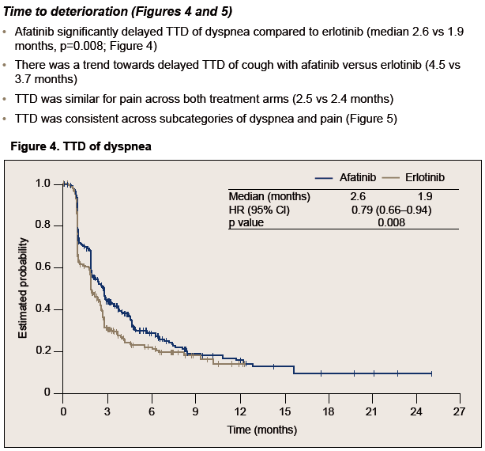
Time to deterioration of dyspnea
Afatinib significantly delayed TTD of dyspnoea compared to erlotinib (median 2.6 vs 1.9 months, p=0.008)
Gadgeel et al. ASCO 2015. Abstract 8100, Poster 425.

Slide 58
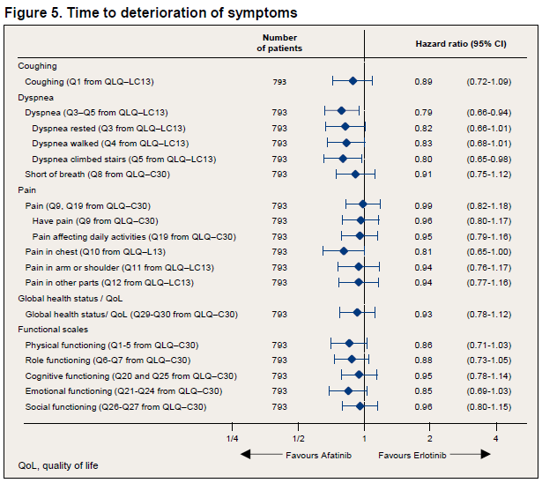
Time to deterioration of symptoms: Sub-categories
Gadgeel et al. ASCO 2015. Abstract 8100, Poster 425.

Slide 59
Status change
OR=1.41
p=0.029
OR=1.33
p=0.061
OR=1.05
p=0.775
OR=1.40
p=0.041
Afatinib
Erlotinib
Patients improved (%)
GHS/QoL
n
339 341
339 340
343 342
339 339
Dyspnea walked: 34.6% vs 26.5%, p=0.022
GHS = global health status..
Gadgeel et al. ASCO 2015. Abstract 8100, Poster 425.

Slide 60
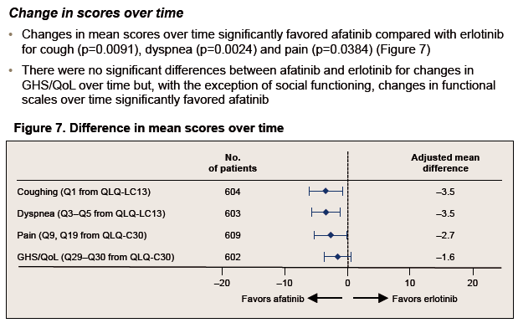
Change in scores over time
There were no significant differences between afatinib and erlotinib for changes in GHS/QoL over time but, with the exception of social functioning, changes in functional scales over time significantly favored afatinib
GHS = global health status..
Gadgeel et al. ASCO 2015. Abstract 8100, Poster 425.

Slide 61
Conclusions
In LUX-Lung 8, significant improvement in OS and PFS achieved with afatinib compared to erlotinib in second-line treatment of SCC was complemented by improvements in PROs
Improvements in several PRO parameters that included GHS/QoL and key lung cancer-associated symptoms were observed across three key analyses
These analyses confirm the clinical meaningfulness of the improvements observed for PFS, OS and tumor response with afatinib compared with erlotinib in LUX-Lung 8
With better efficacy and PROs over erlotinib and a manageable adverse event profile, afatinib should be considered the tyrosine kinase inhibitor of choice for second-line treatment of SCC of the lung
GHS = global health status..
Gadgeel et al. ASCO 2015. Abstract 8100, Poster 425.

Slide 62
Disease Understanding and Treatment Options

Slide 63
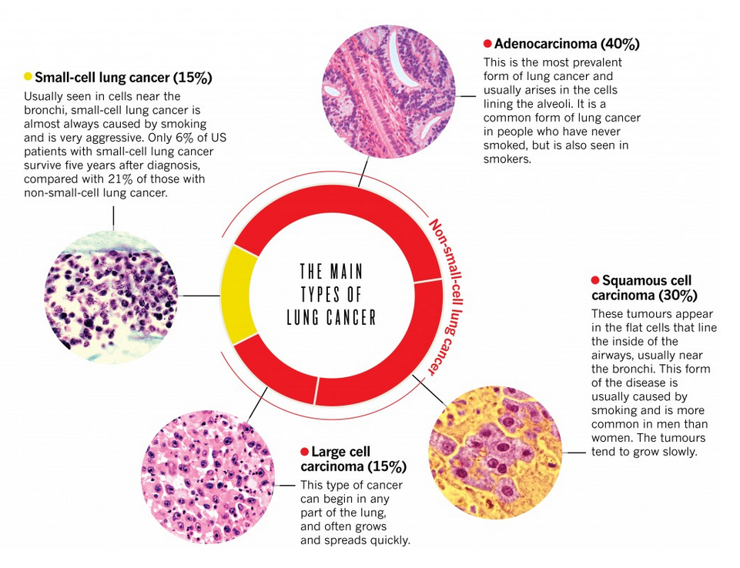
SCC Is a Histologically Distinct NSCLC Subtype
Lung Cancer
Small Cell (≈10%-15%)
NSCLC
(85%-90%)¹
Others (<5%)
(eg, carcinoid)
Large Cell
(15%)
Adenocarcinoma
(50%)
SCC
(20%-30%)
Typical immunoprofile^{2,3}
TTF-1 (-)
p63 (+)
CK7 (-)
CK20 (-)
CK5/6 (+)
Higher likelihood:
Smoker
Central tumour growth
Cavitation
TTF-1 (+)
p63 (-)
CK7 (+)
CK20 (-)
1. Statistics from the American Cancer Society. http://www.cancer.org/cancer/lungcancer-non-smallcell/. Accessed March 9, 2015.
2. NCCN Clinical Practice Guidelines in Oncology–NSCLC. Version 5.2015.
3. Rekhtman et al. Mod Pathol. 2011;24:1348.
Images adapted from Nature Outlook. http://blogs.nature.com/ofschemesandmemes/2014/09/11/the-dominant-malignancy-
lung-cancer. Accessed March 9, 2015.

Slide 64
Squamous Cell Carcinoma of the Lung
Type of NSCLC formed from reserve cells—round cells that replace injured or damaged cells in the lining of the bronchi, the lung’s major airways¹
Usually occurs in the lung’s central portions or in one of the main airway branches, leading to symptoms of cough, dyspnoea, atelectasis, obstructive pneumonia and haemoptysis¹
Treatment options are limited and SCC of the lung is associated with a poor prognosis^{2,3}:
  Median OS after diagnosis of advanced disease is around 4 months³
  The 5-year survival is ≈1.6%³
1. Oliver et al. Am J Clin Oncol. 2015;38:220.
2. Cancer Monthly. Lung Cancer (NSCLC). http://www.cancermonthly.com/cancer_basics/lung.asp. Accessed April 20, 2015.
3. Cetin et al. Clin Epidemiol. 2011;3:139.

Slide 65
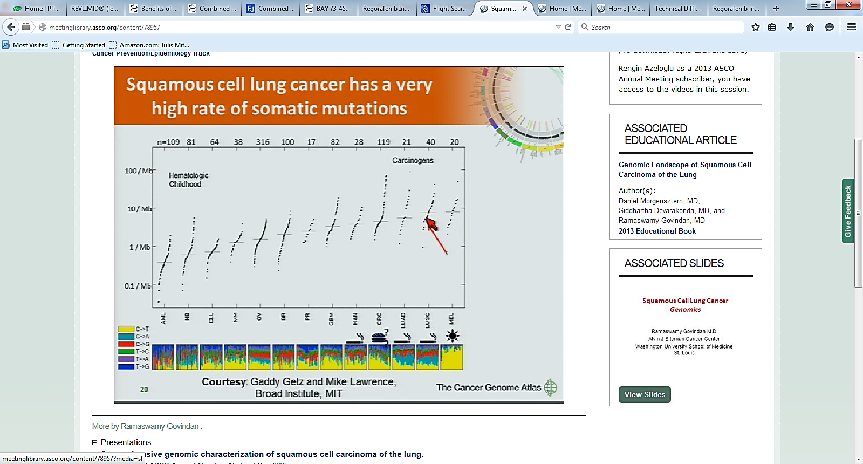
SCC of the Lung Is a Genetically Complex Tumour
SCC has a very high rate of somatic mutations
SCC
Adeno
Siddhartha et al. ASCO 2014. Abstract e22195.

Slide 66
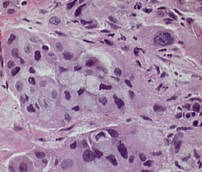
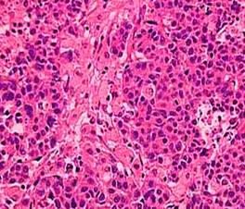
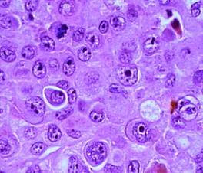
SCC of the Lung Accounts for 20-30% of NSCLC
Classification |  | Charatheristics¹
Non squamous^{c} | Adenocarcinoma 50%ª | Malignant epithelial tumours with glandular differentiation IASLC classification of invasive ADC²: Lepidic, acinar, papillary, micropapillary, or solid pattern predominant Variants: invasive mucinous ADC, colloid, fetal, and enteric
 | Large cell carcinoma 15%ª | Involves large cells (subtypes are giant cell, clear cell) with large nuclei No evidence of squamous or glandular differentiation
Squamous | Squamous cell carcinoma 20%-30%^{b} | Involves cells of the squamous epithelium Two variants of clinicopathologic significance³ Papillary variant Basaloid variant
ªImages from www.surgical-pathology.com.
^{b}Image from http://www.lmp.ualberta.ca/resources/pathoimages/PC-S.htm.
^{c}Other less common subtypes of nonsquamous NSCLC include adenosquamous carcinoma and sarcomatoid carcinoma.³
1. Langer et al. J Clin Oncol. 2010;28:5311; 2. Travis et al. J Thorac Oncol. 2011;4:244; 3. WHO 2004.
Notes:
NSCLC is distinguished from small cell lung cancer based on biology, therapy, and prognosis.¹
The three main histologic subtypes of NSCLC are adenocarcinoma (30–50% of NSCLC), squamous cell carcinoma (30%), and large cell carcinoma (10%).^{1,2} Other less common subtypes of non-squamous NSCLC include adenosquamous carcinoma and sarcomatoid carcinoma.³
Adenocarcinoma is the most common NSCLC histology among non-smokers. Adenocarcinomas are malignant epithelial tumors with glandular differentiation, and can be divided into subtypes, namely acinar, papillary, bronchoalveolar carcinoma (BAC), and solid adenocarcinoma with mucin production. These tumors are usually peripherally located, and common sites of metastatic disease include the brain, bone, adrenal glands, and liver.¹
As the name suggests, large cell carcinomas involve large cells with large nuclei; subtypes include giant cell and clear cell. These tumors have no evidence of squamous or glandular differentiation, and are usually peripherally located.¹
Squamous cell carcinoma involved cells of the squamous epithelium. These tumors are usually centrally located and are associated with smoking history.¹
References
Langer CJ, et al. J Clin Oncol 2010;28:5311–5320.
Heighway J, Betticher DC. Atlas Genet Cytogenet Oncol Haematol. February 2004. From: http://AtlasGeneticsOncology.org/Tumors/LungNonSmallCellID5141.html. Accessed March 2011.
American Cancer Society. 2010. From: www.cancer.org/Cancer/LungCancer-Non-SmallCell/DetailedGuide/index. Accessed March 2011.

Slide 67
NSCLC: Patient Profile and Treatment Options¹⁻³
Classification |  | Patient Profile and Treatment Options
Non squamous^{c} | Adenocarcinoma 50%ª | Younger Also non-/light smokers Better performance status/less comorbidities Treatment options include pemetrexed and bevacizumab Defined oncogene drivers → targeted therapies
 | Large cell carcinoma 15%ª
Squamous | Squamous cell carcinoma 20%-30%^{b} | Older and often with major comorbidities Usually (heavy) Smokers NO pemetrexed or bevacizumab NO approved targeted therapies for any established oncogenic drivers
ªImages from www.surgical-pathology.com.
^{b}Image from http://www.lmp.ualberta.ca/resources/pathoimages/PC-S.htm.
^{c}Other less common subtypes of nonsquamous NSCLC include adenosquamous carcinoma and sarcomatoid carcinoma.³
1. Langer et al. J Clin Oncol. 2010;28:5311; 2. Travis et al. J Thorac Oncol. 2011;4:244; 3. WHO 2004.
Notes:
NSCLC is distinguished from small cell lung cancer based on biology, therapy, and prognosis.¹
The three main histologic subtypes of NSCLC are adenocarcinoma (30–50% of NSCLC), squamous cell carcinoma (30%), and large cell carcinoma (10%).^{1,2} Other less common subtypes of non-squamous NSCLC include adenosquamous carcinoma and sarcomatoid carcinoma.³
Adenocarcinoma is the most common NSCLC histology among non-smokers. Adenocarcinomas are malignant epithelial tumors with glandular differentiation, and can be divided into subtypes, namely acinar, papillary, bronchoalveolar carcinoma (BAC), and solid adenocarcinoma with mucin production. These tumors are usually peripherally located, and common sites of metastatic disease include the brain, bone, adrenal glands, and liver.¹
As the name suggests, large cell carcinomas involve large cells with large nuclei; subtypes include giant cell and clear cell. These tumors have no evidence of squamous or glandular differentiation, and are usually peripherally located.¹
Squamous cell carcinoma involved cells of the squamous epithelium. These tumors are usually centrally located and are associated with smoking history.¹
References
Langer CJ, et al. J Clin Oncol 2010;28:5311–5320.
Heighway J, Betticher DC. Atlas Genet Cytogenet Oncol Haematol. February 2004. From: http://AtlasGeneticsOncology.org/Tumors/LungNonSmallCellID5141.html. Accessed March 2011.
American Cancer Society. 2010. From: www.cancer.org/Cancer/LungCancer-Non-SmallCell/DetailedGuide/index. Accessed March 2011.

Slide 68
Treatments for NSCLC Approved* after 2000
Pemetrexed + cisplatin
Gefitinib
Ceritinib
Pemetrexed
maintenance
Afatinib
Nintedanib
+ docetaxel
Platinum doublet + bevacizumab
Crizotinib
2000 | 2001 | 2002 | 2003 | 2004 | 2005 | 2006 | 2007 | 2008 | 2009 | 2010 | 2011 | 2012 | 2013 | 2014 | 2015
Ramucirumab
+ docetaxel
Docetaxel
Erlotinib
Platinum doublet
Nivolumab
*According to FDA or European Commission approval dates
Registration conditions differ internationally. Thus, the approved indication may not be the same and there may not be an approved SCC indication in all countries. Country-specific information is contained in the locally approved registration documents.
FDA: Food and Drug Administration
Approval information available at: http://www.fda.gov/Drugs/InformationOnDrugs/ucm279174.htm and http://www.ema.europa.eu/
Notes:
1. Livingston et al. Cancer. 1976;37:1237; 2. Scagliotti et al. J Clin Oncol. 2002;20:4285; 3. Sandler et al. N Engl J Med. 2006;355:2542;
4. http://www.astrazeneca.com/Media/Press-releases/Article/20090423--IRESSA-Gefitinib-Recommended-for-Approval-;
5. http://www.fda.gov/AboutFDA/CentersOffices/OfficeofMedicalProductsandTobacco/CDER/ucm209058.htm;
6. http://www.fda.gov/NewsEvents/Newsroom/PressAnnouncements/ucm269856.htm;
7. http://www.fda.gov/Drugs/InformationOnDrugs/ApprovedDrugs/ucm360574.htm;
8. http://www.fda.gov/Drugs/InformationOnDrugs/ApprovedDrugs/ucm395386.htm;
9. http://www.boehringer-ingelheim.com/news/news_releases/press_releases/2014/27_november_2014_oncology.html
10. http://www.fda.gov/Drugs/InformationOnDrugs/ApprovedDrugs/ucm426735.htm
11. http://www.fda.gov/Drugs/InformationOnDrugs/ApprovedDrugs/ucm436566.htm; 12. Shepherd et al. J Clin Oncol. 2000;18:2095.

Slide 69
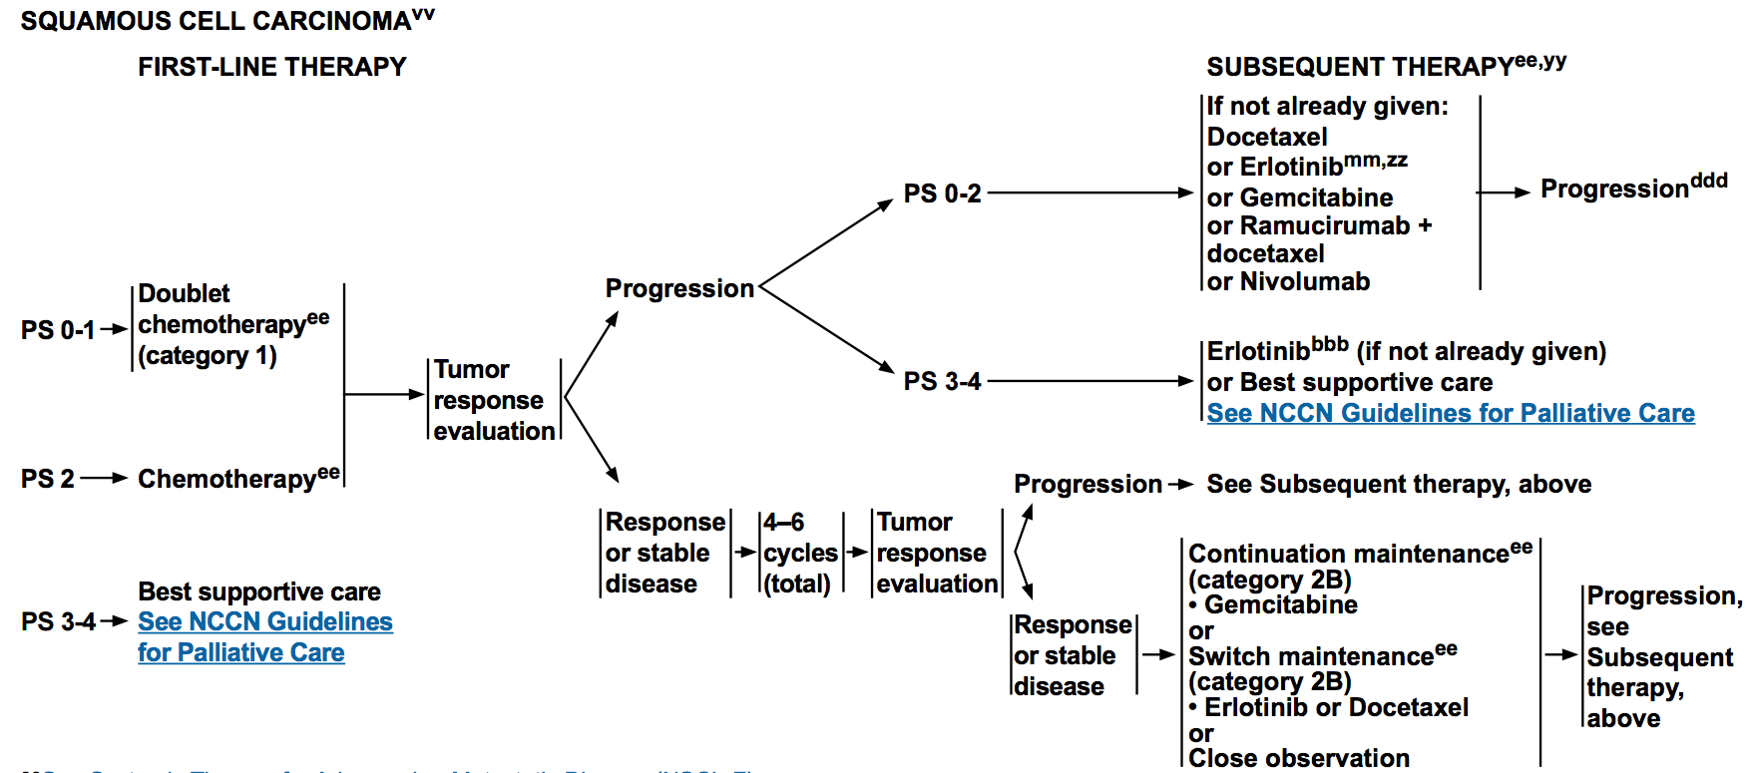
First-Line Treatment of Metastatic SCC of the Lung:
NCCN Guidelines
NCCN = National Comprehensive Cancer Network.
NCCN Clinical Practice Guidelines. NSCLC. Version 6.2015.

Slide 70
First-Line Treatment of Metastatic SCC of the Lung:
ESMO Guidelines
Squamous cell carcinoma
Nonsquamous cell carcinoma
ALK-rearranged
EGFR-mutation negative/unknown
EGFR-mutation positive
1st-Line
Cisplatin +
3rd-gen CT
ALK TKI
Cisplatin +
3rd-gen CT
EGFR TKI
ESMO = European Society for Medical Oncology; CT = chemotherapy; ALK = anaplastic lymphoma kinase; TKI = tyrosine kinase inhibitor.
Modified from Reck et al. Ann Oncol. 2014;25(suppl 3):iii27 and Besse et al. Ann Oncol. 2014;25:1475.

Slide 71
First-Line Treatment for SCC of the Lung:
Platinum-Based Doublet Chemotherapy
Platinum-based CT (carboplatin or cisplatin plus third-generation CTª) has been the recommended first-line treatment for advanced NSCLC
  Meta-analysis in 1995 showed a 10% improvement in survival at 1 year
  compared with BSC^{1,2}
  Equivalent efficacy in nonsquamous vs squamous³⁻⁵
Another meta-analysis (9 trials, 2968 patients) showed improved radiologic response rates for cisplatin compared with carboplatin-based regimens, but only showed an increase in OS if used in nonsquamous histologic subtypes or in combination with third-generation CT^{a,6}
Cisplatin-based regimens were associated with a higher rate of nausea, vomiting and nephrotoxicity, whereas carboplatin was associated with increased thrombocytopenia⁶
ªPaclitaxel, docetaxel, gemcitabine or vinorelbine.
BSC = best supportive care.
1. Travis et al. WHO Classification of Tumours. 2004:9.2. Reck et al. Ann Oncol. 2014;25(suppl 3);iii27; 3. Schiller et al. N Engl J Med. 2002;346:92.
4. Kelly et al. J Clin Oncol. 2001;19:3210; 5. Pilkington et al. Thorax. 2015;70:359; 6. Ardizzoni et al. J Natl Cancer Inst. 2007;99:847.
Notes:
1. Travis et al. WHO Classification of Tumours;IARC Press, Lyon, France, 2004:9-124
2. Reck et al. Ann Oncol 2014;25 Suppl 3;iii27-39
3. Schiller et al. N Engl J Med 2002;346(2):92-98
4. Kelly et al. J Clin Oncol 2001;19(13):3210-3218
5. Pilkington et al. Thorax 2015;70(4),359-367
6. Ardizzoni et al. J Natl Cancer Inst 2007;99(11):847-857

Slide 72
First-Line Treatment for SCC of the Lung:
Platinum-Based Doublet Chemotherapy (cont’d)
1.0
Median (95% CI)
CP | 9.4 | (8.4, | 10.2)
CG | 10.8 | (9.5, | 12.1)
CP vs CG | Adjusted HR (95% CI)
 | 1.23 | (1.00, | 1.51)
1.0
Median (95% CI)
CP | 4.4 | (4.1, | 4.9)
CG | 5.5 | (4.6, | 5.9)
CP vs CG | Adjusted HR (95% CI)
 | 1.36 | (1.12, | 1.65)
0.9
0.9
0.8
0.8
0.7
0.7
0.6
0.6
0.5
Survival Probability
PFS Probability
0.5
0.4
0.4
0.3
0.3
0.2
0.2
0.1
0.1
0
0
6
12
18
24
30
0
0
6
12
18
24
30
Survival in Patients With SCC (mo)
PFS in Patients With SCC (mo)
CP = cisplatin + pemetrexed; CG = cisplatin + gemcitabine.
Scagliotti et al. J Clin Oncol. 2008;26:3543.

Slide 73
Pemetrexed-Based CT in SCC of the Lung
Pemetrexed-based CT is only recommended for non-SCC
  First line: cisplatin/pemetrexed provided a significant OS benefit of 1.7-3.7 months compared with cisplatin/gemcitabine for non-SCC, whereas SCC had a significantly longer OS of 1.4 months with cisplatin/gemcitabine¹
  Second line: pemetrexed provided an OS advantage for non-SCC
  (HR 0.78, P=0.047), whereas SCC had a shorter OS (HR 1.56; P=0.018) (vs docetaxel)²
A potential explanation for the different clinical behaviour of pemetrexed is that SCC tumours express higher levels of thymidylate synthase, the main target of pemetrexed, with higher expression levels being associated with resistance^{3,4}
  As such, pemetrexed-based chemotherapy is not recommended in any setting for SCC
1. Scagliotti et al. J Clin Oncol. 2008;26:3543; 2. Scagliotti et al. Oncologist. 2009;14:253.
3. Ceppi et al. Cancer. 2006;107:1589; 4. Shih et al. Cancer Res. 1997;57:1116.
Notes:
Scagliotti et al. J Clin Oncol 2008;26(21):3543-3551
Scagliotti et al. Oncologist 2009;14(3):253-263
Ceppi et al. Cancer 2006;107(7):1589-1596
Shih et al. Cancer Res 1997;57(6):1116-1123

Slide 74
Second-Line Treatment of Metastatic SCC of the Lung:
NCCN Guidelines
NCCN Clinical Practice Guidelines. NSCLC. Version 6.2015.

Slide 75
Second-Line Treatment of Metastatic SCC of the Lung:
ESMO Guidelines
Squamous cell carcinoma
Nonsquamous cell carcinoma
ALK-rearranged
EGFR-mutation negative/unknown
EGFR-mutation positive
1st-Line
Cisplatin +
3rd-gen CT
ALK TKI
Cisplatin +
3rd-gen CT
EGFR TKI
Prior
chemotherapy
Prior
EGFR TKI
Docetaxel or EGFR TKI
Prior platinum- based treatment
Docetaxel or pemetrexed or erlotinib
EGFR TKI
Platinum doublet
2nd-Line
Prior chemotherapy
Crizotinib
Platinum doublet
Prior crizotinib
Modified from Reck et al. Ann Oncol. 2014;25(suppl 3):iii27 and Besse et al. Ann Oncol. 2014;25:1475.

Slide 76
Second-Line Chemotherapy for advanced NSCLC
Doublet CT fails to improve OS and increases toxicity compared with single agent¹
Docetaxel vs BSC in NSCLC: TAX317 trial²:
  Docetaxel vs BSC upon progression after platinum-based CT as first-line, showed a significant improvement in OS (7.5 vs 4.6 months, P=0.010) as well disease-related symptoms with docetaxel
  Docetaxel was associated with significant toxicity
  Docetaxel vs vinorelbine or ifosfamide—TAX320 trial³:
    Similar results to docetaxel as in TAX317
  In contrast to pemetrexed, the efficacy of docetaxel has not been found to vary by histologic subtype⁴
1. Di Maio et al. J Clin Oncol. 2009;27:1836.
2. Shepherd et al. J Clin Oncol. 2000;18:2095.
3. Fossella et al. J Clin Oncol. 2000;18:2354.
4. Scagliotti et al. Oncologist. 2009;14:253.
Notes:
Di Maio et al. J Clin Oncol 2009;27(11):1836-1843
Shepherd et al. J Clin Oncol 2000;18(10):2095-2103
Fossella et al. J Clin Oncol 2000;18(12):2354-2362
Scagliotti et al. Oncologist 2009;14(3):253-263

Slide 77
TAX 317: Docetaxel vs BSC in Second-Line Treatment for advanced NSCLC
Overall Survival with Docetaxel 75mg/m²
1.0
0.9
Docetaxel (n=55): Median OS 7.5 mo
0.8
BSC (n=49): Median OS 4.6 mo
0.7
Log-rank test P=0.010
0.6
Cumulative Probability
0.5
0.4
0.3
0.2
0.1
0
0
3
6
9
12
15
18
21
Months
  Shepherd et al. J Clin Oncol. 2000;18:2095.

Slide 78
BR 21: Trial Design
Squamous: 144 (29.5%)
Erlotinib
150 mg daily
n=488
Stage IIIB or IV NSCLC
(all histologies)
One or two prior chemo regimens
ECOG PS: 0-3
N=731
R
A
N
D
O
M
I
S
E
2:1
Placebo
“150 mg” daily
n=243
Stratification:
Center
PS: 0/1 vs 2/3
Response to prior Rx: CR/PR vs SD vs PD
Prior regimens: 1 vs 2
Prior platinum therapy: Yes vs no
Squamous: 78 (32.1%)
Primary endpoint: OS
Secondary endpoints: PFS, ORR, DOR, toxicity and QoL
  Shepherd et al. N Engl J Med. 2005;352:123

Slide 79
BR 21: Erlotinib vs Placebo in Second-Line Treatment for advanced NSCLC
Overall Survival
Adenocarcinoma
Squamous cell carcinoma
HR=0.71 (0.56-0.92)
HR=0.67 (0.50-0.90)
1.00
1.00
Erlotinib (n=246)
Median 7.8 mo
Erlotinib (n=144)
Median 5.6 mo
0.75
0.75
Placebo (n=119)
Median 5.4 mo
Placebo (n=78)
Median 3.6 mo
Survival Distribution Function
0.50
0.50
0.25
0.25
+-
0
0
0
5
10
15
20
30
0
5
10
15
20
25
Months
Months
  Shepherd et al. N Engl J Med. 2005;352:123.
  Clark et al. Clin Lung Cancer. 2006;7:389.

Slide 80
Label of Approved Drugs in Second Line Treatment
At the time of Trial Design in 2011
Docetaxel
  As a single agent is indicated for the treatment of patients with locally advanced or metastatic NSCLC after failure of prior platinum-based CT
Erlotinib
  Treatment of locally advanced or metastatic NSCLC after failure of ≥1 prior CT regimen
  Maintenance treatment of patients with locally advanced or metastatic NSCLC whose disease has not progressed after 4 cycles of platinum-based, first-line CT
Both drugs were approved on the basis of placebo-controlled trials that included all histologies, and both showed OS improvement
Erlotinib mechanistic profile of targeting EGFR and oral posology, similar efficacy but better tolerability comparing to docetaxel, made it the obvious choice for comparing with afatinib in LUX-Lung 8
    Any new evidence after 2011 regarding Erlotinib vs Docetaxel?

Slide 81
TAILOR (2012): Erlotinib vs Docetaxel in
Second Line Treatment in NSCLC
Advanced/recurrent NSCLC
Previous platinum-based doublet
EGFR wild-type
KRAS determined
ECOG PS 0-2
Docetaxel
75 mg/m² IV days
1,21 or
35 mg/m² IV
days 1,8,15,28
CROSS OVER NOT ALLOWED
R
STRATIFICATION
Centre
Recurrent/progressed
Type of prior chemotherapy regimen
(pemetrexed vs gemcitabine vs vinorelbine)
ECOG PS (0-1 vs 2)
Adequacy of tissue sample (optimal vs suboptimal)
1:1
Erlotinib
150 mg PO, daily
Results in 222 pts (ITT): OS improvement with docetaxel vs erlotinib
(8.2 vs 5.4m; HR 0.73, 95% CI 0.53-1.00, p=0.05)
Conclusion of the trial:
Chemotherapy is more effective than erlotinib for second-line treatment for previously treated patients with NSCLC who have wild-type EGFR tumours
Garassino et al. Lancet Oncol. 2013;14:981.

Slide 82
TAILOR: Erlotinib vs Docetaxel in
Second Line Treatment in NSCLC (cont’d)
OS: ADC vs SCC Histology
Docetaxel Group |  | Erlotinib Group |  | Hazard Ratio (95% CI) | P_{interaction}
Performance status
0-1 | 85/103 | 86/100 |  | 0.80 (0.59-1.07) | 0.81
2 | 7/7 | 9/9 |  | 0.87 (0.31-2.47)
Histology
Adenocarcinoma | 69/83 | 63/69 |  | 0.67 (0.48-0.95) | 0.14
Squamous | 19/23 | 25/31 |  | 0.90 (0.49-1.65)
Other | 4/4 | 7/9 |  | 2.32 (0.62-8.74)
0.5
0.7
1
1.5
2.0
Favours docetaxel
Favours erlotinib
In the subgroup of patients with squamous histology
the OS did not differ between treatment groups
Garassino et al. Lancet Oncol. 2013;14:981.

Slide 83
Meta-analysis (2014): EGFR TKIs vs Chemotherapy as Second-Line Treatment in Advanced NSCLC
Clinical trials available through PubMed, Embase, Cochrane (CENTRAL), ASCO, ESMO, and World Conference of Lung Cancer were screened
Selection criteria
    EGFR-TKI vs standard second-line CT (docetaxel or pemetrexed)
    Prospective randomised trial
    Patients previously treated with platinum compounds
    Sufficient data to calculate effect measure
10 randomised trials were identified composed of 3825 NSCLC patients
Data were analysed on an ITT basis
Outcome measures:
PFSª
OSª
ORR
RR
Grade 3-4 toxicities
ªEGFR mutation–positive and EGFR mutation–negative subgroups were pooled.
ITT = intention-to-treat; ORR = objective response rate; RR = response rate.
Li et al. PLoS One. 2014;9:e102777.

Slide 84
Meta-analysis (2014): EGFR TKIs vs Chemotherapy as Second-Line Treatment (cont’d)
OS Comparison*
Study |  | HR (95% CI)
SIGN 2006 |  | 0.97 (0.61, 1.52)
INTEREST 2008 |  | 1.02 (0.91, 1.15)
V-15-32 2008 |  | 1.12 (0.89, 1.40)
ISTANA 2010 |  | 0.87 (0.61, 1.24)
TITAN 2012 |  | 0.96 (0.78, 1.19)
KCSG-LU08-01 2012 |  | 0.80 (0.50, 1.30)
HORG 2013 |  | 0.99 (0.80, 1.24)
DELTA 2013 |  | 0.91 (0.68, 1.22)
Overall (I-squared = 0.0%, P=0.879) |  | 1.00 (0.92, 1.08)
0.5
1
2
Favours
EGFR TKIs
Favours
Chemotherapy
Li et al. PLoS One. 2014;9:e102777.

Slide 85
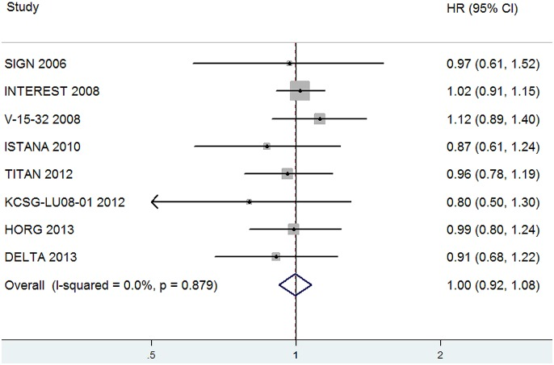
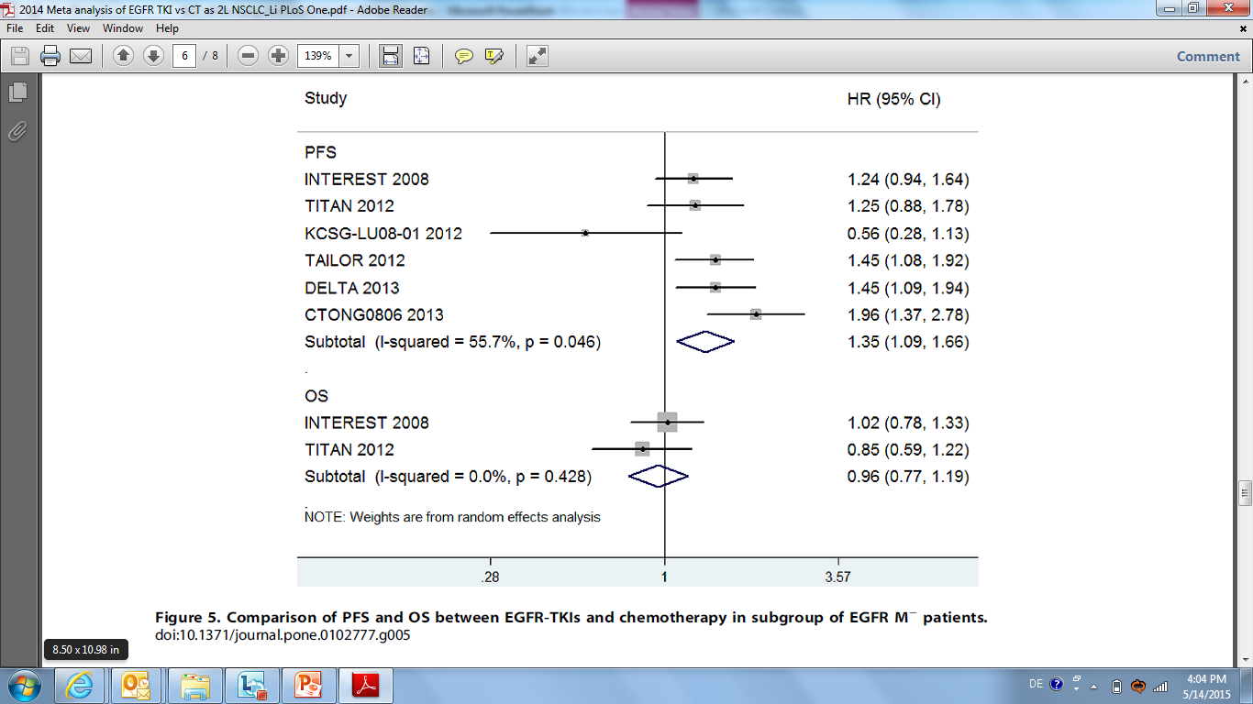
Meta-analysis (2014): EGFR TKIs vs Chemotherapy as Second-Line Treatment (cont’d)
OS Comparison in the subgroup of EGFR wild type patients*
Favours
EGFR TKIs
Favours
Chemotherapy
*TAILOR was not included in the OS comparison at that time the OS data hadn‘t been reported yet
Li et al. PLoS One. 2014;9:e102777.

Slide 86
Label of Approved Drugs in Second Line Treatment
Docetaxel
  As a single agent is indicated for the treatment of patients with locally advanced or metastatic NSCLC after failure of prior platinum-based CT
Erlotinib
  Treatment of locally advanced or metastatic NSCLC after failure of ≥1 prior CT regimen
  Maintenance treatment of patients with locally advanced or metastatic NSCLC whose disease has not progressed after 4 cycles of platinum-based, first-line CT
Recent additions (US)
Ramucirumab + docetaxel (Dec 12, 2014)
  Treatment of metastatic NSCLC with disease progression on or after platinum-based CT
Nivolumab (Mar 5, 2015)
  Treatment of metastatic squamous NSCLC with progression on or after platinum-based CT

Slide 87
Antiangiogenesis in the Treatment of SCC Lung

Slide 88
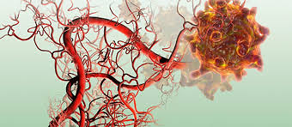
Antiangiogenesis in the Treatment of NSCLC
Angiogenesis is important for the development and growth of tumours beyond a certain size¹
Signaling cascades involved in angiogenesis include VEGF and PDGF as well as other pathways²
Antiangiogenic approaches have been demonstrated to be active in a number of solid tumors including NSCLC³
Angiogenesis in tumour growth and development⁴
1. www.cancer.gov/about-cancer/treatment/types/immunotherapy/angiogenesis-inhibitors-fact-sheet. Accessed May 19, 2015.
2. Rolfo et al. Expert Opin Investig Drugs. 2013;22:1081.
3. Sandler et al. N Engl J Med. 2006;355:2542.
4. http://www.nyas.org/Publications/EBriefings/Detail.aspx?cid=6fe7e173-b02e-4b8f-a8cb-7c0e3de1d5ed.
Accessed January 26, 2015.

Slide 89
Antiangiogenic Approaches in the Treatment of SCC of the Lung
 | No. of Patients With SCC | Regimen | Results
Johnson et al.¹ | Total: 13 7.5 mg/kg: 10 15 mg/kg: 3 | Bevacizumab (7.5 or 15 mg/kg) + CP vs CP | 6 patients experienced a major life-threatening bleeding described as haemoptysis or haematemesis; 4 events were fatal; 4 of the severe haemorrhages occurred in 13 patients with SCC
Scagliotti et al.² | Total: 223 Treatment: 109 (23%) Control: 114 (25%) | Sorafenib + CP vs Placebo + CP | The study was terminated because it was highly unlikely to meet its primary endpoint of OS Patients with SCC had greater risk for mortality in sorafenib arm than in control arm (HR 1.85; 95% CI, 1.22-2.81) SCC may be associated with a greater incidence of fatal bleeding events (including fatal pulmonary haemorrhage), irrespective of treatment
Scagliotti et al.³ | Total: 223 Treatment: NA Control: NA | Motesanib + CP vs Placebo + CP | In November 2008, the DMC recommended that enrollment of all patients be halted and treatment of SCC be discontinued because of higher early mortality and a higher incidence of gross haemoptysis compared with placebo
C = carboplatin; P = paclitaxel; NA = not available; DMC = Data Monitoring Committee.
1. Johnson et al. J Clin Oncol. 2004;22:2184.
2. Scagliotti et al. J Clin Oncol. 2010;28:1835.
3. Scagliotti et al. J Clin Oncol. 2012;30:2829.

Slide 90
Antiangiogenic Approaches in the Treatment of SCC of the Lung (cont’d)
 | No. of Patients With SCC | Regimen | Results
Reck et al.¹ | Total: 555 Treatment: 276 (42.1%) Control: 279 (42.3%) | Nintedanib + D vs Placebo + D | PFS (by central independent review) was significantly longer in the nintedanib + D group than in the placebo + D group (Adeno: HR=0.77; 95% CI, 0.62-0.96, P=0.0193; SCC: HR 0.77; 95% CI, 0.62-0.96, P=0.02) There was no difference in OS between the 2 groups for patients with SCC (HR 1.01; 95% CI, 0.85-1.21, P=0.8907) There was a low incidence of class effects typically associated with antiangiogenic agents, such as hypertension, bleeding, perforation, and thromboembolism, which have been noted with other antiangiogenic agents in NSCLC
D = docetaxel
1. Reck et al. Lancet Oncol. 2014;15:143.

Slide 91
REVEL: Ramucirumab + Docetaxel in Second-Line
Treatment for NSCLC
Ramucirumab: A fully human IgG1 mAb targets extracelluar domain of VEGFR-2
Squamous: 157 (25%)
Stage IV NSCLC
after 1 platinum-based chemo,
+/- maintenance
Prior bevacizumab allowed
ECOG PS: 0-1
All histologies
N=1253
Ramucirumab (10 mg/kg)
+
Docetaxel (75 mg/m²)
n=628
R
A
N
D
O
M
I
S
E
1:1
Placebo
+
Docetaxel (75 mg/m²)
n=625
Stratification Factors:
ECOG PS: 0-1
Gender
Prior maintenance
East Asia vs ROW
Squamous: 171 (27%)
Primary endpoint: OS
Secondary endpoints: PFS, ORR, safety, PRO
mAb = monoclonal antibody; VEGFR-2 = VEGF receptor 2; ROW = rest of world;
PRO = patient-reported outcomes.
Garon et al. Lancet. 2014;384:665.

Slide 92
REVEL: OS and PFS (ITT)
OS
PFS
 | Median (95% CI) | Censoring Rate
Ramucirumab plus docetaxel | 10.5 mo (9.5-11.2) | 31.8%
Placebo plus docetaxel | 9.1 mo (8.4-10.0) | 27.0%
Ramucirumab vs placebo | Stratified HR 0.86 (95% CI, 0.75-0.98) P=0.023
 | Median (95% CI) | Censoring Rate
Ramucirumab plus docetaxel | 4.5 mo (4.2-5.4) | 11.1%
Placebo plus docetaxel | 3.0 mo (2.8-3.9) | 6.7%
Ramucirumab vs placebo | Stratified HR 0.76 (95% CI, 0.68-0.86) P<0.0001
1.0
1.0
0.9
0.9
0.8
0.8
0.7
0.7
0.6
0.6
Ramucirumab plus docetaxel
Placebo plus docetaxel
Censored
0.5
0.5
Overall Survival
Progression-Free Survival
0.4
0.4
0.3
0.3
0.2
Ramucirumab plus docetaxel
Placebo plus docetaxel
Censored
0.2
0.1
0.1
0
0
3
6
9
12
15
18
21
24
27
30
33
36
0
0
3
6
9
12
15
18
21
24
27
30
Months
Months
Number at risk
Ramucirumab 628 527 415 329 231 156 103 70 45 23 11 2 0
plus docetaxel
Placebo plus 625 501 386 306 197 129 86 56 36 23 9 0 0
docetaxel
Number at risk
Ramucirumab 628 383 204 120 59 38 11 7 3 3 0
plus docetaxel
Placebo plus 625 301 172 95 37 17 9 4 3 2 0
docetaxel
Garon et al. Lancet. 2014;384:665.

Slide 93
REVEL: OS and PFS in SCC subgroup
OS
PFS
 | Median (95% CI) | Censoring Rate
Ramucirumab plus docetaxel | 9.5 mo (8.0-10.8) | 21.7%
Placebo plus docetaxel | 8.2 mo (6.3-9.4) | 19.9%
Ramucirumab vs placebo | HR (95% CI) 0.883 (0.692-1.127) Log-rank P value 0.319
 | Median (95% CI) | Censoring Rate
Ramucirumab plus docetaxel | 4.2 mo (3.6-5.4) | 10.2%
Placebo plus docetaxel | 2.7 mo (2.5-2.9) | 8.2%
Ramucirumab vs placebo | HR (95% CI) 0.761 (0.606-0.957) Log-rank P value 0.019
1.0
1.0
0.9
0.9
0.8
0.8
0.7
Ramucirumab plus docetaxel
Placebo plus docetaxel
Censored
0.7
Ramucirumab plus docetaxel
Placebo plus docetaxel
Censored
0.6
0.6
0.5
Overall Survival
0.5
Progression-Free Survival
0.4
0.4
0.3
0.3
0.2
0.2
0.1
0.1
0
0
0
3
6
9
12
15
18
21
24
27
30
33
36
0
3
6
9
12
15
18
21
24
Months
Months
Patients at risk
Ramucirumab 157 124 103 78 49 31 23 16 6 2 1 1 0
plus docetaxel
Placebo plus 171 132 99 75 48 31 20 14 8 5 4 0 0
docetaxel
Patients at risk
Ramucirumab 157 91 47 26 11 8 1 1 0
plus docetaxel
Placebo plus 171 68 39 20 7 4 2 1 0
docetaxel
Garon et al. Lancet. 2014;384:665.

Slide 94
REVEL: Haematologic AEs by Histology
 |  | Nonsquamous |  |  | Squamous
Treatment Emergent Adverse Events | Grade | Ramucirumab (n=465) | Placebo (n=441) |  | Ramucirumab (n=157) | Placebo (n=170)
Haematologic Adverse Events
Neutropeniaª | Any | 253 (54.4)^{b} | 196 (44.4) |  | 88 (56.1) | 83 (48.8)
 | 3/4/5 | 224 (48.2)^{b} | 171 (38.8) |  | 78 (49.7) | 70 (41.2)
Leukopeniaª | Any | 93 (20.0) | 82 (18.6) |  | 40 (25.5) | 32 (18.8)
 | 3/4/5 | 56 (12.0) | 52 (11.8) |  | 29 (18.5) | 23 (13.5)
Anaemiaª | Any | 93 (20.0)^{b} | 117 (26.5) |  | 37 (23.6) | 53 (31.2)
 | 3/4/5 | 14 (3.0) | 25 (5.7) |  | 4 (2.5) | 9 (5.3)
Febrile neutropenia | Any | 75 (16.1)^{b} | 42 (9.5) |  | 25 (15.9) | 20 (11.8)
 | 3/4/5 | 75 (16.1)^{b} | 42 (9.5) |  | 25 (15.9) | 20 (11.8)
Thrombocytopeniaª | Any | 53 (11.4)^{b} | 21 (4.8) |  | 31 (19.7)^{b} | 11 (6.5)
 | 3/4/5 | 12 (2.6)^{b} | 3 (0.7) |  | 6 (3.8) | 1 (0.6)
ªConsolidated AE category comprising synonymous MedDRA preferred terms.
^{b}P<0.05 for between-treatment group; comparison based on Fisher’s exact test.
Garon et al. Lancet. 2014;384:665.

Slide 95
REVEL: AEs of Interests by Histology
 |  | Nonsquamous |  |  | Squamous
Treatment Emergent Adverse Events | Grade | Ramucirumab (n=465) | Placebo (n=441) |  | Ramucirumab (n=157) | Placebo (n=170)
Adverse Events of Special Interest
Bleeding/ haemorrhageª | Any | 145 (31.2)^{b} | 60 (13.6) |  | 36 (22.9) | 33 (19.4)
 | 3/4/5 | 11 (2.4) | 8 (1.8) |  | 4 (2.5) | 5 (2.9)
Epistaxis | Any | 97 (20.9)^{b} | 30 (6.8) |  | 19 (12.1)^{b} | 9 (5.3)
 | 3/4/5 | 2 (0.4) | 0 (0.0) |  | 0 (0.0) | 0 (0.0)
Gastrointestinal haemorrhageª | Any | 14 (3.0) | 7 (1.6) |  | 3 (1.9) | 3 (1.8)
 | 3/4/5 | 3 (0.6) | 1 (0.2) |  | 1 (0.6) | 1 (0.6)
Pulmonary haemorrhageª | Any | 34 (7.3) | 25 (5.7) |  | 15 (9.6) | 21 (12.4)
 | 3/4/5 | 5 (1.1) | 4 (0.9) |  | 3 (1.9) | 4 (2.4)
Haemoptysis | Any | 25 (5.4) | 16 (3.6) |  | 11 (7.0) | 16 (9.4)
 | 3/4/5 | 3 (0.6) | 2 (0.5) |  | 1 (0.6) | 2 (1.2)
Hypertensionª | Any | 54 (11.6)^{b} | 23 (5.2) |  | 14 (8.9) | 6 (3.5)
 | 3/4/5 | 27 (5.8)^{b} | 13 (2.9) |  | 8 (5.1)^{b} | 0 (0.0)
Infusion-related reactionª | Any | 18 (3.9) | 20 (4.5) |  | 5 (3.2) | 8 (4.7)
 | 3/4/5 | 4 (0.9) | 3 (0.7) |  | 1 (0.6) | 1 (0.6)
Proteinuria | Any | 15 (3.2)^{b} | 5 (1.1) |  | 6 (3.8)^{b} | 0 (0.0)
 | 3/4/5 | 1 (0.2) | 0 (0.0) |  | 0 (0.0) | 0 (0.0)
ªConsolidated AE category comprising synonymous MedDRA preferred terms.
^{b}P<0.05 for between-treatment group; comparison based on Fisher’s exact test.
Garon et al. Lancet. 2014;384:665.

Slide 96
REVEL: AEs of Interests by Histology (cont’d)
 |  | Nonsquamous |  |  | Squamous
Treatment Emergent Adverse Events | Grade | Ramucirumab (n=465) | Placebo (n=441) |  | Ramucirumab (n=157) | Placebo (n=170)
Adverse Events of Special Interest
Venous thromboembolicª | Any | 9 (1.9)^{b} | 27 (6.1) |  | 7 (4.5) | 8 (4.7)
 | 3/4/5 | 7 (1.5) | 15 (3.4) |  | 4 (2.5) | 3 (1.8)
Renal failureª | Any | 11 (2.4) | 11 (2.5) |  | 3 (1.9) | 3 (1.8)
 | 3/4/5 | 2 (0.4) | 1 (0.2) |  | 1 (0.6) | 1 (0.6)
Arterial thromboembolicª | Any | 6 (1.3) | 10 (2.3) |  | 4 (2.5) | 2 (1.2)
 | 3/4/5 | 3 (0.6) | 7 (1.6) |  | 3 (1.9) | 0 (0.0)
Congestive heart failureª | Any | 6 (1.3) | 3 (0.7) |  | 0 (0.0) | 1 (0.6)
 | 3/4/5 | 5 (1.1) | 0 (0.0) |  | 0 (0.0) | 1 (0.6)
Gastrointestinal perforationª | Any | 5 (1.1) | 1 (0.2) |  | 1 (0.6) | 1 (0.6)
 | 3/4/5 | 4 (0.9) | 1 (0.2) |  | 1 (0.6) | 1 (0.6)
ªConsolidated AE category comprising synonymous MedDRA preferred terms.
^{b}P<0.05 for between-treatment group; comparison based on Fisher’s exact test.
Garon et al. Lancet. 2014;384:665.

Slide 97
Immunotherapy in the Treatment of SCC Lung

Slide 98
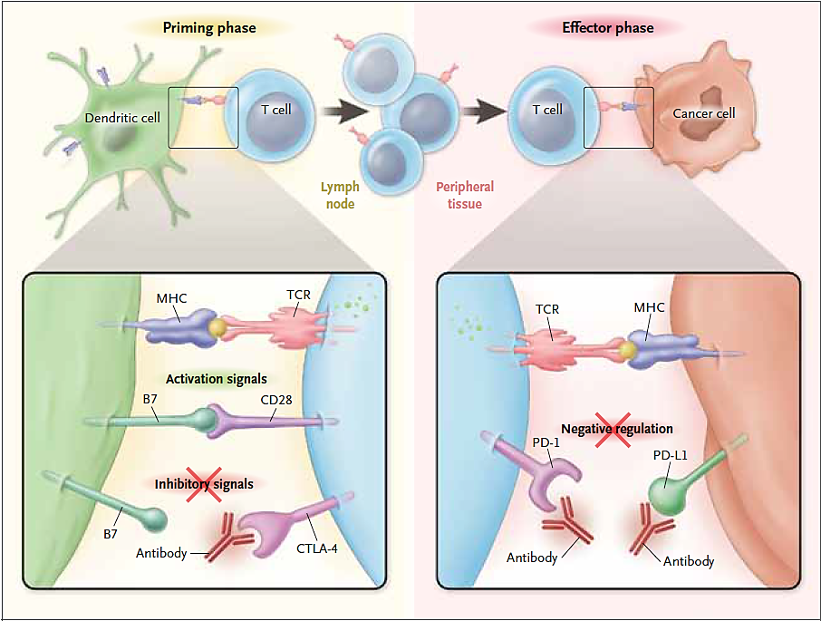
Immunotherapy in the Treatment of NSCLC:
Immune Checkpoint Inhibitors
Ipilimumab
Nivolumab
Pembrolizumab
MPDL3280A
MEDI4736
Ribas. N Engl J Med. 2012;366:2517.

Slide 99
Nivolumab Lung Cancer Development Programme
Phase 1
Phase 2
Phase 3
Nivo
Mono Tx
Nivolumab NSCLC
(-012)
Comb Tx
Mono + Comb
1st line
Nivolumab NSCLC
PD-L1+ (-026)
New Nivolumab Combination Regimensª
(>5)
Nivolumab + Yervoy
(planned)
Nivolumab NSCLC Squamous (-063)
≥2nd line
Nivolumab NSCLC
(-003)
Nivolumab NSCLC Squamous (-017)
Nivolumab SCLC
(-032)
Nivolumab NSCLC nonsquamous (-057)
ªIncludes collaborations.
Ramalingam. CMSTO 2014.

Slide 100
CheckMate-063: Trial Design
Phase 2 Nivolumab in Advanced, Third-Line + Squamous Cell Lung Cancer
endpoints
Primary:
Confirmed ORR (IRC assessed)
Secondary:
Confirmed ORR (investigator assessed)
Exploratory:
Safety and tolerability
PFS/OS
PD-L1 expression and efficacy
Stage lllB/IV
SQ NSCLC
≥2 lines of prior systemic therapies
Nivolumab 3 mg/kg IV q2wk
Treat until progression or intolerable toxicity
Tumour assessments (per RECIST v1.1) performed at week 8 and every 6 weeks
Minimum of 11 months of follow-up for response
Median OS fellow-up was 8 months (range, 0-17.3)
Ramalingam. CMSTO 2014.

Slide 101
CheckMate-063: Overall Survival
1.0
Median OS, mo (95% CI) | 8.2 (6.1-11)
1-year OS rate, % (95% CI) | 41 (32-50)
Number of events | 72/117
0.9
0.8
0.7
Median OS = 8.2 months
0.6
1-year OS = 41%
Probability of Survival
0.5
0.4
0.3
0.2
0.1
0
0
3
6
9
12
15
18
Months
Number of Patients at Risk
Nivolumab 3 mg/kg | 117 | 93 | 68 | 51 | 28 | 5 | 0
Median follow-up for OS: 8 months (range, 0-17)
Green circles represent censored observations.
Ramalingam. CMSTO 2014.

Slide 102
CheckMate-063: Other Endpoints
ORR by PD-L1 Expression (IRC Assessed)
 | IRC Assessed (per RECIST 1.1)ª
ORR, % (n) [95% CI] | 15 (17) [9-22]
Disease control rate, % (n) | 40 (47)
Median DOR, mo (range) | NR (2+ to 12+)
Ongoing responders, % (n) | 76 (13)
Median time to response, mo (range) | 3 (2-9)
Median PFS, mo (95% CI) | 2 (2-3)
PFS rate at 1-year, % (95% CI) | 20 (13-29)
76 evaluable samplesª
Subgroups |  | ORR, % (n/N)
Overall |  | 15 (17/117)
PD-L1 | ≥1% | 20 (9/45)
 | <1% | 13 (4/31)
 | ≥5% | 24 (6/25)
 | <5% | 14 (7/51)
 | Indeterminate/NE^{b} | 30 (3/10)
Safety:
Discontinued due to adverse reactions: 27%
Drug delay for an adverse reaction: 29%
Serious adverse reactions: 59%
Most frequent serious adverse reactions reported in at least 2% of patients were:
  Dyspnoea, pneumonia, chronic obstructive pulmonary disease exacerbation, pneumonitis, hypercalcemia, pleural effusion, hemoptysis, and pain
ªJuly 2014 DBL.
^{b}No quantifiable PD-L1 expression.
NR = not reached; DOR = duration of response; NE = not evaluable.
Opdivo (nivolumab) prescribing information.
Rizvi et al. Lancet Oncol. 2015;16:257.

Slide 103
CheckMate-017: Trial Design
An open-label randomised phase 3 trial of BMS-936558 (nivolumab) vs docetaxel in previously treated advanced or metastatic squamous cell NSCLC
Patients with:
Confirmed squamous cell NSCLC
Stage IIIB/IV disease or recurrent or progressive disease following multimodal therapy (radiation therapy, surgical resection, or chemoradiation therapy for locally advanced disease)
Disease recurrence or progression after 1 prior platinum doublet-based CT regimen for advanced or metastatic disease
No prior treatment with anti-PD-1, anti-PD-L1, anti-PD-L2, anti-CD137, or anti-CTLA-4 antibody, or docetaxel
ECOG PS 0-1
Pre-treatment (archival or fresh) tumor samples required for PD-L1 analysis
Randomise
Stratification by region and prior paclitaxel use
1:1
Nivolumab (3 mg/kg)
IV q2wk
(n=135)
Docetaxel (75 mg/m²)
IV q3wk
(n=137)
Primary endpoints: OS
Secondary endpoints: ORR, PFS (by IRR), correlation between PD-L1 expression and efficacy, QoL (LCSS)
Spigel et al. ASCO 2015 Abstract 8009
Brahmer et al. N Engl J Med published on May 31, 2015

Slide 104
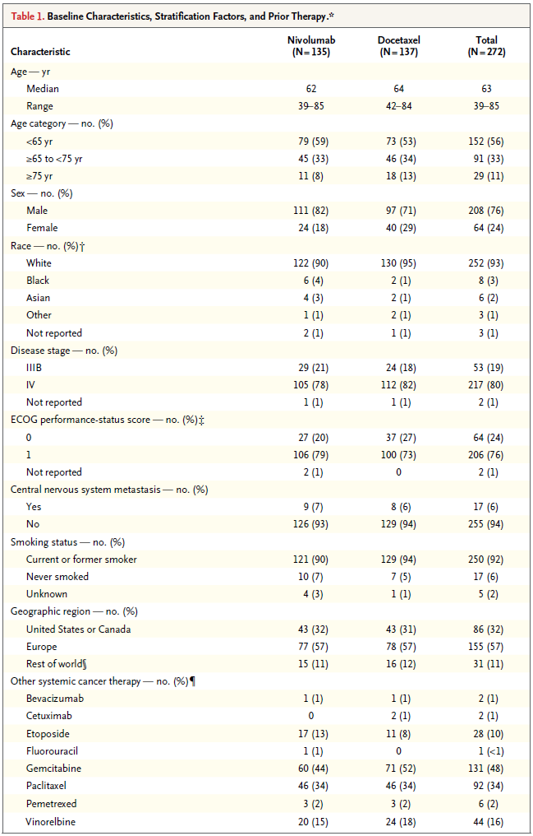
CheckMate-017: Baseline Characteristics
Spigel et al. ASCO 2015 Abstract 8009
Brahmer et al. N Engl J Med published on May 31, 2015

Slide 105
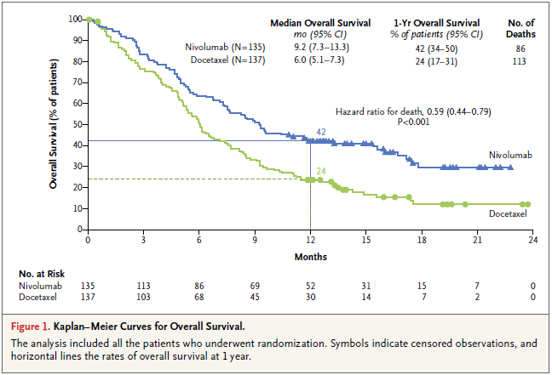
CheckMate-017: Overall Survival
At time of DBL (Dec 15, 2014), 199 deaths were reported (86% of deaths required for final analysis)
Spigel et al. ASCO 2015 Abstract 8009
Brahmer et al. N Engl J Med published on May 31, 2015

Slide 106
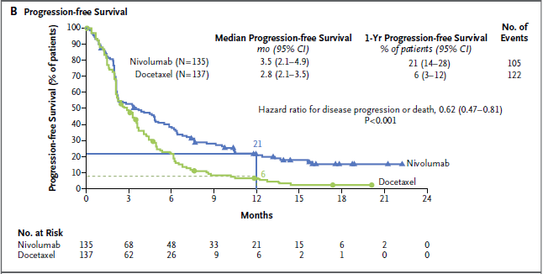
CheckMate-017: Progression Free Survival
PFS defined as the time from randomization to the date of the first documented event of tumor progression, death or last tumor assessment that could be evaluated (data-censoring date).
The analysis included all the patients who underwent randomization.
Spigel et al. ASCO 2015 Abstract 8009
Brahmer et al. N Engl J Med published on May 31, 2015
Notes:
Spigel et al. ASCO 2015 Abstract #8009

Slide 107
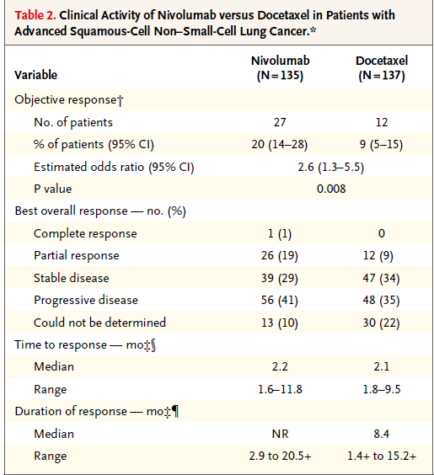
CheckMate-017: Objective Response Rate
28 pts in the nivolumab arm were treated beyond RECIST v1.1-defined progression
Non-conventional benefit was observed in 9 pts (not included in ORR)
Spigel et al. ASCO 2015 Abstract 8009
Brahmer et al. N Engl J Med published on May 31, 2015

Slide 108
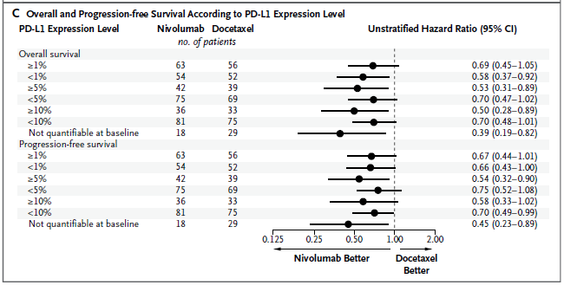
CheckMate-017: OS, PFS and ORR by PD-L1 Expression Level
ORR by PD-L1 Expression Level
 | ≥1% | <1% | ≥5% | <5% | ≥10% | <10% | NA
Nivolumab ORR, % (n/N) | 18 (11/63) | 17 (9/54) | 21 (9/42) | 15 (11/75) | 19 (7/36) | 16 /13/81) | 39 (7/18)
Docetaxel ORR, % (n/N) | 11 (6/56) | 10 (5/52) | 8 (3/39) | 12 (8/69) | 9 (3/33) | 11 (8/75) | 3 (1/29)
Interaction p-value | 0.94 |  | 0.29 |  | 0.64
Spigel et al. ASCO 2015 Abstract 8009
Brahmer et al. N Engl J Med published on May 31, 2015

Slide 109
CheckMate-017: Treatment and Safety Summary
 | Nivolumab N=131 |  | Docetaxel n-=129
 | Any Grade | Grade 3-5ª | Any Grade | Grade 3-5
Treatment-related AEs, % | 58 | 7 | 86 | 57
Treatment-related AEs leading to discontinuation, % | 3^{b} | 2 | 10^{c} | 7
Treatment-related deaths, % | 0 |  | 2^{d}
Median number of doses was 8 (range, 1-48) for nivolumab and 3 (range, 1-29) for docetaxel
ª No grade 5 events were reported with nivolumab. ^{b} 1% patients had increased ALT/AST, increased lipase, myasthenic syndrome, or rash, and 2% patients had pneumonitis. ^{c} Peripheral neuropathy (3%) and fatigue (2%). ^{d} Interstitial lung disease, pulmonary hemorrhage, and sepsis (1 patient each).
Spigel et al. ASCO 2015 Abstract 8009
Brahmer et al. N Engl J Med published on May 31, 2015

Slide 110
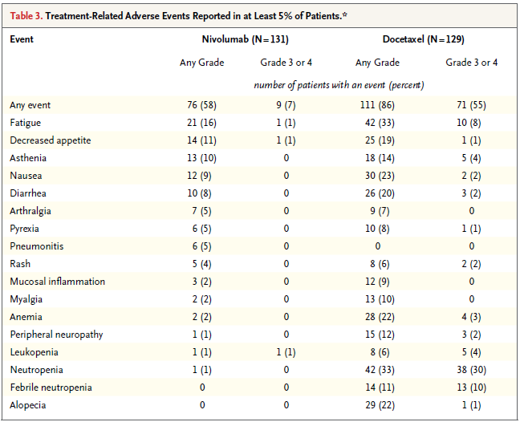
CheckMate-017: Treatment-related AEs
(≥5% of patients)
Spigel et al. ASCO 2015 Abstract 8009
Brahmer et al. N Engl J Med published on May 31, 2015

Slide 111
CheckMate-017: Summary
Nivolumab is the first PD-1 inhibitor to demonstrate a survival benefit versus standard-of-care docetaxel in previously-treated patients with advanced SQ NSCLC
  41% reduction in risk of death (HR 0.59; P=0.00025)
  1-yr OS: 42% vs 24%
  mOS: 9.2m vs 6.0m
Nivolumab demonstrated superiority over docetaxel across all secondary efficacy endpoints
  ORR: 20% vs 9% (P=0.0083)
Nivolumab benefit was independent of PD-L1 expression
The safety profile of nivolumab was favourable versus docetaxel and consistent with prior studies
Nivolumab received FDA approval in the US on March 4, 2015 for metastatic SQ-NSCLC with progression on or after platinum-based chemotherapy
Spigel et al. ASCO 2015 Abstract 8009

Slide 112
Targeting EGFR in the Treatment of SCC Lung

Slide 113
FLEX: Cetuximab Plus Chemotherapy in First-Line NSCLC
Squamous: 190 (34%)
Primary endpoint: OS
Secondary endpoints: PFS, ORR, QoL, and safety
Cetuximab
(starting 400 mg d1, then 250 mg/m²/wk)
+
Cisplatin (80 mg/m²) d1
+
Vinorelbine (25 mg/m²) d1, 8 up to 6 cycles
n=557
Stage IIIB (wet) or IV
chemo-naive NSCLC
EGFR+ by IHC
No brain mets
N=1125
R
A
N
D
O
M
I
S
E
1:1
Cisplatin (80 mg/m²) d1
+
Vinorelbine d1, 8 up to 6 cycles
n=568
Squamous: 187 (33%)
Pirker et al. Lancet. 2009;373:1525.

Slide 114
FLEX: OS (ITT) and in High EGFR-Expressing SCC
ITT
High EGFR-expressing SCC
Median OS (mo)
Cetuximab + chemo: 11.3
Chemo: 10.1
HR 0.871 (95% CI, 0.762-0.996; P=0.044)
OS (mo)
 | Median | 1 Year
Cetuximab + chemo | 11.2 | 44%
Chemo | 8.9 | 25%
HR 0.62 (95% CI, 0.43-0.88)
100
100
90
90
80
80
70
70
60
60
50
50
Overall Survival (%)
Overall Survival (%)
40
40
30
30
20
20
10
10
0
0
0
6
12
18
24
30
0
6
12
18
24
30
Months
Months
Number at risk
Chemotherapy 557 383 251 155 53 3
plus cetuximab
Chemotherapy 568 383 225 134 48 0
Number at risk
Chemotherapy 75 52 32 19 10 0
plus cetuximab
Chemotherapy 69 42 17 7 2 0
.
Pirker et al. Lancet. 2009;373:1525.
Pirker et al. Lancet Oncol. 2012;13:33.

Slide 115
SQUIRE: Necitumumab plus Gemcitabine-Cisplatin in First-Line in SCC of the Lung
Gem-Cis + Neci q2w (n=545)
Necitumumab (800 mg d1, d8)
Gemcitabine (1250 mg/m² d1, d8)
Cisplatin (75 mg/m² d1)
PR
Neci q3w
(800 mg d1, d8)
CR
PD
SD
Screening
Entry criteria:
Stage IV squamous
NSCLC
ECOG PS 0-2
R
1:1
PD
Maximum of 6 cycles
Gem-Cis q3w (n=548)
Gemcitabine (1250 mg/m² d1, d8)
Cisplatin (75 mg/m² d1)
PD
Randomisation (R) stratified by: ECOG PS (0-1 vs 2) and geographic region
(North America, Europe, and Australia vs South America, South America, South Africa,
and India vs East Asia)
Patient selection not based on EGFR protein expression
Radiographic tumour assessment (investigator read): at baseline and every 6 weeks until PD
Mandatory tissue collection
Primary endpoint: OS
Secondary endpoints: PFS, ORR, and safety
Thatcher et al. ASCO 2014. Abstract 8008.

Slide 116
SQUIRE: OS (ITT)
100
 | Patients | Events | Median OS (mo)
Gem-Cis + Neci | 545 | 418 | 11.5
Gem-Cis | 548 | 442 | 9.9
HR (95% CI) P value | 0.84 (0.74-0.96) P=0.012ª
80
60
Overall Survival (%)
40
20
0
0
2
4
6
8
10
12
14
16
18
20
22
24
26
28
30
32
34
36
38
40
Months Since Randomisation
No. at risk
Gem-Cis + Neci 545 496 450 407 358 291 243 208 176 130 101 84 61 42 32 20 11 3 3 0 0
Gem-Cis 548 494 435 379 308 254 219 182 153 115 80 63 49 33 27 19 9 7 3 1 0
ªLog-rank test (stratified).
Thatcher et al. ASCO 2014. Abstract 8008.
Notes:
Post-progression anticancer therapy: N+GC vs. GC
47% vs. 45%

Slide 117
SQUIRE: PFS by Investigator (ITT)
Median PFS, mo (95% CI)
Gem-Cis + Neci | 5.7 (5.6-6.0)
Gem-Cis | 5.5 (4.8-5.6)
HR (95% CI) P value | 0.85 (0.74-0.98) P=0.020ª
Hazard ratio
0.85 | ITT population (N=1093)
0.82 | <70 y (n=888)
1.07 | ≥70 y (n=205)
0.63 | Female (n=185)
0.90 | Male (n=908)
0.88 | Caucasian (n=913)
0.70 | Non-Caucasian (n=913)
0.88 | Ex-light & non-smoker (n=97)
0.85 | Smoker (n=995)
0.84 | PS 0 (n=344)
0.86 | PS 1(n=652)
0.79 | PS 2 (n=96)
100
80
60
Progression-Free Survival (%)
40
20
0
0
4
8
12
16
20
24
28
32
0.5
1.0
1.5
Months Since Randomisation
Favours
Gem-Cis + Neci
Favours Gem-Cis
ªLog-rank test (stratified).
Thatcher et al. ASCO 2014. Abstract 8008.

Slide 118
SQUIRE: Adverse Events
 | % of Patients
 | Gem-Cis + Neci (n=538) |  | Gem-Cis (n=541)
Event Categoryª | Any Grade | Grade ≥3 | Any Grade | Grade ≥3
Neutropenia | 43.7 | 24.3 | 45.8 | 27.5
Febrile neutropenia | 1.1 | 0.7 | 1.5 | 1.3
Anaemia | 41.8 | 10.6 | 45.8 | 10.9
Thrombocytopenia | 21.7 | 10.2 | 27.0 | 10.7
Fatigue | 42.6 | 7.2 | 42.5 | 7.0
Hypomagnesaemia | 31.2 | 9.3 | 15.7 | 1.1
Skin rash | 76.2 | 7.1 | 10.2 | 0.4
Hypersensitivity/infusion-related reaction | 1.5 | 0.4 | 2.0 | 0
Conjunctivitis | 7.4 | 0.4 | 2.2 | 0
Interstitial lung disease (pneumonitis) | 0.9 | 0.4^{b} | 0.7 | 0.6
Arterial thromboembolic events | 5.4 | 3.9^{c} | 3.9 | 2.0^{c}
Venous thromboembolic events | 9.1 | 5.0^{d} | 5.4 | 2.6^{d}
ªAdverse events grouped by medical concept, selected according to treatment relevance.
^{b}Includes 1 fatal event of pneumonitis (0.2%).
^{c}Fatal arterial thromboembolic events, n(%): Gem-Cis + Neci 3 (0.6%), Gem-Cis 1 (0.2%).
^{d}Fatal venous thromboembolic events, n(%): Gem-Cis + Neci 1 (0.2%), Gem-Cis 1 (0.2%).
Thatcher et al. ASCO 2014. Abstract 8008.

Slide 119
Other Potentially Targetable Mutations in the Treatment of SCC

Slide 120
Frequency of Other Potentially Targetable Mutations in SCC of the Lung
4%
22%
33%
5%
1%
2%
Perez-Moreno et al. Clin Cancer Res. 2012;18:2443.

Slide 121
FGFR Inhibition: BGJ398
Phase 1 dose-escalation study enrolled patients ≥18 years of age with any FGFR genetically altered tumour, progressed after at least 1 line of therapy, including platinum (SCC cohort: N=21)
  FGFR 1-amplified tumours were identified by FISH/CISH
BGJ398: 100-150 mg once daily in 28-day cycles
Results: 17 evaluable patients
  2 PR, lasting about 8 and 3 months
  2 additional PRs after the data cutoff date
  3 additional patients had SD with tumour regression (up to 11% reduction)
Safety
  Manageable and reversible hyperphosphatemia, stomatitis, alopecia, decreased appetite, and fatigue
Conclusion
  These data encourage further development of BGJ398 in FGFR1-amplified SCC and efforts to optimise predictive biomarkers for FGFR inhibitor sensitivity
FISH/CISH = fluorescence in situ hybridisation/chromogenic in situ hybridisation.
Nogova et al. ASCO 2014. Abstract 8034.

Slide 122
FGFR Inhibition: AZD4547
A multicentre phase 1 expansion of AZD4547 in patients with previously treated stage IV FGFR1-amplified SCC
  FGFR1 amplification was confirmed through central FISH (n=13) or review of local results (n=2)
AZD4547 80 mg PO twice daily continuously in a q3wk cycle
Results
  15 patients were treated. 1 PR, 4 SD, 9 PD (7 progressions and 2 deaths)
    The 1 PR was observed in a patient with high FGFR1 amplification
Safety
  The most common related AEs were gastrointestinal and dermatologic
  Grade ≥3 related AEs occurred in 3 patients (20%) (central serous retinopathy, hyponatremia, dehydration)
Conclusions
  AZD4547 was well tolerated in patients with FGFR1-amplified squamous cell lung cancer but did not meet its prespecified efficacy endpoint in terms of ORR for continuation
Paik et al. ASCO 2014. Abstract 8035.

Slide 123
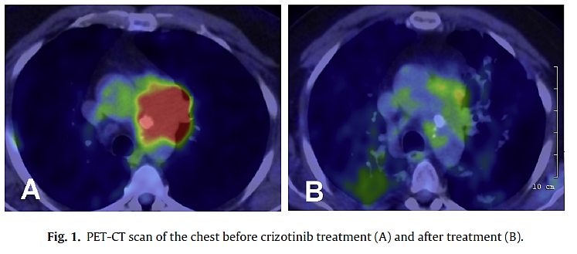
c-Met Inhibition: Crizotinib
Case report of 73-year-old Caucasian male with advanced SCC
Tumour biopsy¹
  Wild-type EGFR, KRAS, PIK3CA, and no ALK or ROS1 rearrangement
  c-Met amplified shown by FISH
Rationale for c-Met inhibition¹
  c-Met amplification: 3.9-21% of SCC cases; high copy number associated with worse prognosis and shorter OS
  Secondary c-Met amplification as a potential resistant mechanism to EGFR-targeted TKIs
Treatment: Crizotinib monotherapy at standard dose (250 mg 2× per day)¹
Result: PR (confirmed by chest and PET/CT after 8 weeks)¹
  c-Met inhibitors might be an effective treatment option for SCC patients
Development of c-Met inhibitor in SCC: Phase 1 combination trial of crizotinib and dacomitinib in patients with NSCLC including SCC was terminated²
Before
c-Met amplified SCC
After
PET/CT = positron emission tomography/computed tomography.
1. Schwab et al. Lung Cancer. 2014;83:109.
2. https://www.clinicaltrials.gov/ct2/show/NCT01441128?term=c-Met&cond=Squamous+Cell+Non-small+Cell+
Lung+Cancer & rank=1. Accessed May 2015.

Slide 124
DDR2 Inhibition: Dasatinib
An open-label, phase 2 study of dasatinib in patients with advanced stage lung SCC who had failed standard chemotherapy
Dasatinib 140 mg daily in 28-day cycles
Results
  The study was halted after enrolling 5 patients, all of whom were discontinued from the trial due to excess toxicity
Safety
  3 of 5 (60%) patients experienced grade ≥3 toxicities (dyspnoea, fatigue, AST elevation, anorexia, nausea)
  Intolerable grade 2 pleural effusions were noted in 2 of 5 patients
Conclusions
  Dasatinib administered at 140 mg/d for the treatment of advanced SCC is associated with excess AEs, similar to other studies, so is not recommended in unselected patients
DDR2 = discoidin domain receptor tyrosine kinase 2; AST = aspartate aminotransferase.
Brunner et al. J Thorac Oncol. 2013;8:1434.

Slide 125
Overview of Key Competitors Timelines

Slide 126
Key Competitors - Timelines
Events for Key Competitors |  | 2015 |  |  |  | 2016 |  |  |  | 2017 |  |  |  | 2018 |  | 2019 |  | 2020
ErbB | GIOTRIF approved in SCC indication
VEGF R2 Ab | Ramucirumab + docetaxel approval in 2L NSCLC
EGFR Ab | Necitumumab (+gemcitabine+cisplatin) approval in 1L SCC
PD-1 Ab | Nivolumab approval in ≥2L SCC
 | Nivolumab approval in 1L NSCLC in PDL1+ patients (CHECKMATE-026)
 | Pembrolizumab approved in: - 2L NSCLC PDL1+ (KEYNOTE 10) - 1L NSCLC PDL1+ (KEYNOTE 24)
PDL-1 Ab | MPDL-3280A approval in: - ≥2L NSCLC - 2L NSCLC (PhIII): “Oak“ - All Lines PDL1+ (phII): “Birch“
EU
US
US
EU
US
EU
US
EU
D
US
D
US
US
US
Based on Roche Press release on 29th Jan 2015
EU
Anticipated launch scenario based on early termination of BIRCH trial
D
US
US
  Nivolumab had an early launch in 2L/3L SCC; PD1 inhibitors are anticipated to have a major impact on treatment algorithm
  Necitumumab U.S. launch is expected mid 2015; it may have a positive effect on the relevance of ErbB inhibition in this disease. Acceptance of subsequent ErbB inhibition needs to be ascertained
  Several combination trials of above compounds have been either already initiated or are planned to begin in 2015.
D
Data
L
Launch

Slide 127
Overview of Trials in Second Line Treatment

Slide 128
Trials in Second Line Treatment
Chemo/chemo-backbone
Trial | Treatment | Median PFS (mo) | HR for PFS | Median OS (mo) | HR for OS | ORR (%) | Safety profile
JMEI | Pemetrexed vs doce (n=571) Squamous (n=172) | 2.9 vs 2.9 2.3 vs 2.7 | 0.97 1.4* | 8.3 vs 7.9 6.2 vs 7.4 | 0.99 1.56* | 9.1 vs 8.8 2.8 vs. 8.1 | 13% FN; 24% hospitalization
ZODIAC | Vandetanib + doce vs doce (n=727) Squamous (n=344) | 4.0 vs 3.2 | 0.79 0.79 | 10.6 vs 10.0 | 0.91 0.98 | 17 vs 10 | 9% FN
ZEAL | Vandetanib + pem vs pem (n=1391) Squamous (n=114) | 4.1 vs 2.8 | 0.86 1.04 | 10.5 vs 9.2 | 0.86 1.08 | 19 vs 8 | 52% grade ≥ 3 AEs
LUME-Lung 1 | Nintedanib + doce vs doce (n=1314) Squamous (n=487) | 3.4 vs 2.7 2.9 vs 2.6 | 0.79 0.77* | 10.1 vs 9.1 8.6 vs 8.7 | 0.94 1.01 | 4.4 vs. 3.3 4.7 vs. 2.2 | >70% grade ≥ 3 AEs; 7% FN
REVEL | Ramucimurab + doce vs doce (n=1253) Squamous (n=328) | 4.5 vs 3.0 4.2 vs 2.7 | 0.76 0.76* | 10.5 vs 9.1 9.5 vs 8.2 | 0.86 0.88 | 23.0 vs 13.6 26.7 vs 10.5 | >70% grade ≥ 3 AEs; 16% FN;
FN: febrile neutropenia
Hanna N et al. J Clin Oncol. (2004) 1;22(9):1589-97.; Scagliotti G et al. The Oncologist (2009); 14(3):253-263.
Herbst RS et al. The Lancet Oncology (2010); 11(7):619-626; De Boer RH et al. J Clin Oncol. (2011);29(8):1067-74
Reck M et al. Lancet Oncology (2014): 143-155; Garon E et al Lancet Oncology (2014):epub

Slide 129
Trials in Second Line Treatment
EGFR TKI
Trial | Treatment | Median PFS (mo) | HR for PFS | Median OS (mo) | HR for OS | ORR (%) | Safety profile
BR.21 | Erlotinib vs placebo (n=727) Squamous (n=222) | 2.2 vs 1.8 | 0.61 | 6.7 vs 4.7 5.6 vs. 3.6 | 0.70 0.67* | 9 vs 1 4 vs ?
ZEST | Vandetanib vs erlotinib (n=1240) Squamous (n=272) | 2.6 vs 2.0 | 0.98 1.09 | 6.9 vs 7.8 | 1.01 1.25 | 12vs12 | 50% grade ≥ 3
BETA | Erlotinib + bev vs erlotinib (n=636) Squamous (n=28) | 3.4 vs 1.7 | 0.62 | 9.3 vs 9.2 | 0.97 0.91 | 13 vs 6 | 60% grade ≥ 3
TITAN | Doce/pem vs erlotinib, fast PD (n=304) Squamous (n=154) | 2.2 vs 1.6 | 1.19 | 5.5 vs 5.3 | 0.96 0.86 | 8 vs 6 | 31% grade ≥ 3
SUN1087 | Sunitinib + erlotinib vs erlotinib (n=960) Squamous (n=270) | 3.6 vs 2.0 | 0.81 0.8 | 9.0 vs 8.5 | 0.92 0.94 | 11 vs 7
TAILOR | Doce vs erlotinib, EGFR wt (n=222) Squamous (n=54) | 2.9 vs 2.4 | 0.72* 0.57 | 8.2 vs 5.4 | 0.78 0.90 | 15 vs 3 | 5% FN
DELTA | Erlotinib vs doce (n=301) Squamous (n=61) | 2.0 vs 3.2 | 1.22 1.60* | 14.8 vs 12.2 | 0.91 | 17 vs18 | 15% FN
ARCHER 1009 | Dacomitinib vs erlotinib (n=878) | 2.6 vs 2.6 | 0.94 | 7.9 vs 8.4 | 1.08 | 11 vs 8 | 11% G3 diarrhoea
Shepherd FA et al. N Engl J Med (2005); 353(2):123-132
Natale RB et al. J Clin Oncol. (2011) Mar 10;29(8):1059-66
Herbst RS et al. Lancet. (2011);377(9780):1846-54.
Ciuleanu T et al. Lancet Oncol. (2012): (3):300-8
Scagliotti GV, at el. J Clin Oncol. (2012);30(17):2070-8
Garrassino et al Lancet Oncol (2013)
Kawaguchi T et al. J Clin Oncol (2014); 32; 1902-1908
Ramalingam S et al. J Clin Oncol 32:5s, 2014 (suppl; abstr 8018)

Slide 130
Clinical Trials in NSCLC
Immunotherapies
Trial | Treatment | Median PFS (mo) | HR for PFS | Median OS (mo) | HR for OS | ORR (%) | Safety profile
CHECKMATE-063 (phII) | Nivolumab (single arm) All squamous; ≥3L (n=117) | 2.0 | - | 8.2 (1yr OS=41%) | - | 15% | 17% Grade≥3
CHECKMATE-017 (phIII) | Nivolumab vs doce All squamous (n=272) | 3.5 vs 2.8 | 0.62 | 9.2 vs 6.0 | 0.59 | 20 vs 9 | 7% Grade≥3
Ramalingam. CMSTO 2014.
Brahmer et al. N Engl J Med published on May 31, 2015

Slide 131
JMEI Trial
Trial | Treatment | Median PFS (mo) | HR for PFS | Median OS (mo) | HR for OS | ORR (%) | Safety profile
JMEI | Pemetrexed vs doce (n=571) Squamous (n=172) | 2.9 vs 2.9 2.3 vs 2.7 | 0.97 1.4* | 8.3 vs 7.9 6.2 vs 7.4 | 0.99 1.56* | 9.1 vs 8.8 2.8 vs. 8.1 | See below additional information
Trial Population:
Patients with stage III or IV disease not amenable to curative therapy
PS 0 to 2
Previous treatment with one prior chemotherapy regimen for advanced NSCLC
Patients received pemetrexed 500 mg/m2 IV day 1 or docetaxel 75 mg/m2 IV day 1
Patient stratification:
PS (0 or 1 v 2), prior platinum or paclitaxel use, number of prior CT regimens (1 or 2), time since last chemotherapy
(<3 v ≥ 3 months), best response to last chemotherapy (DCR versus PD/unknown), stage (III v IV), …
Primary endpoint : OS
Results:
571 patients randomized; 28% in pemetrexed and 32% in docetaxel were SCC
1 year survival rate for each arm was 29.7%
Safety: docetaxel arm with higher frequence of grade 3 or 4 neutropenia (40.2% v 5.3%; P .001), FN (12.7% v 1.9%; P .001), neutropenia with infections (3.3% v 0.0%; P .004), hospitalizations for neutropenic fever (13.4% v 1.5%; P .001), hospitalizations due to other DRAE (10.5% v 6.4%; P .092), use of granulocyte colony-stimulating factor support (19.2% v 2.6%, P .001) and all grade alopecia (37.7% v 6.4%; P .001) compared with pemetrexed arm.
Hanna N et al. J Clin Oncol. (2004) 1;22(9):1589-97.

Slide 132
TAILOR (Italian trial)
Trial | Treatment | Median PFS (mo) | HR for PFS | Median OS (mo) | HR for OS | ORR (%) | Safety profile
TAILOR | Doce vs erlotinib, EGFR wt (n=222) Squamous (n=54) | 2.9 vs 2.4 | 0.72* 0.57 | 8.2 vs 5.4 | 0.78 0.90 | 15 vs 3 | 5% FN
Trial Population:
Patients with advanced NSCLC, wild-type EGFR, with prior platinum-based chemotherapy
PS 0 to 2
Patient stratification:
PS (0 or 1 v 2), centre, stage, type of 1L (pemetrexed vs gemcitabine vs vinorelbine)
Primary endpoint: OS
Results/Comments docetaxel/erlotinib:
48% PS0, 44-45% PS1 and 6-8% PS2; 21-28% Squamous histology; 27-17% never smokers
In erlotinib group grade 3-4 skin Aes were not associated with OS, PFS or RR (the low number of events might also have reduced the size of the association)
Docetaxel was better than erlotinib in never smokers (HR 0.50, ss) and adenocarcinoma (HR

Slide 133
Scientific Response Points (SRPs)

Slide 134
Scientific Response Points
Trial Design and Baseline Characteristics
What is the rationale for studying EGFR TKIs in SCC of the lung? Does SCC have a low incidence of EGFR mutations?
Why was erlotinib chosen as the control arm, since it is not used that much in this setting?
Why is the total patient population different in the primary analysis than in the overall survival analysis?
Why was the randomisation stratified by East Asian vs non-East Asian patients?
Efficacy
I believe that these data are mainly driven by the imbalances in never-smokers (probably those with EGFR mutations).
I think erlotinib is underdosed, as plasma levels are lower in heavy smokers.
PFS and OS differences are marginal. Data are not clinically meaningful.
Safety
Safety profile is not that comparable, since the nature of the AEs is quite different.
The trial just confirmed what we already know: afatinib is a little better but more toxic.
How many patients escalated to 50 mg? Was the safety profile different from the overall population?
What was the starting dose? Why did you allow an increase to 50 mg?
Afatinib is more toxic; more patients needed a dose reduction than with erlotinib.

Slide 135
Scientific Response Points (cont’d)
Biomarkers and subgroups
Is the effect on OS/PFS primarily driven by patients with EGFR mutation positive tumours?
Is there a different clinical/molecular feature in the early vs late progressing population?
Patients with SD as best response to first line had a more pronounced OS benefit. Can you explain?
Trials/Competitors comparison
Docetaxel is more efficacious than erlotinib, so I will continue using reserve a TKI for later lines.
How relevant are these data in light of the TAILOR/DELTA trials?
Nivolumab is/will be available, so TKIs are relegated to third or fourth line as a last option.
Ramucirumab plus docetaxel showed even better data in the subgroup of patients with squamous histology.
Efficacy of afatinib in other SCC
Are there afatinib data in other squamous cell carcinomas?

Slide 136
SRP 1: What is the rationale for studying EGFR TKIs in SCC of the lung? Does SCC have a low incidence of EGFR mutations?
SCC of the lung is known to have high EGFR overexpression and gene amplification, aberrations of other ErbB receptors (including ErbB3 overexpression in 30%), and dysregulation of downstream pathway has been implicated in pathobiology of SCC^{1,2} These findings likely account for the benefits these patients derive from erlotinib³⁻⁵ and other EGFR-directed therapiesª in various treatment settings, despite the low frequency of EGFR-activating mutations⁶ Supportive evidence: 1) The incidence of ErbB alterations in SCC of the lung¹⁻¹²: High EGFR gene copy-number and protein overexpression, EGFR mutations = 1%–5%; EGFRvIII mutants = 5%–8% , ErbB4 mutations = ≈2%–3%, ErbB3 mutations = ≈1% 2) Other EGFR-targeted agents provided OS benefit: ªcetuximab^{13,14} or ªnecitumumab¹⁵ when added to first-line platinum doublet chemotherapy vs doublet chemotherapy only.
1. Hirsch et al. J Clin Oncol. 2003;21:3798; 2. Lopez-Malpartida et al. Lung Cancer. 2009;65:25; 3. Shepherd et al. N Engl J Med. 2005;352:123;
4. Clark et al. Clin Lung Cancer. 2006;7:389; 5. Leon et al. ESMO 2008. 1277P; 6. Dearden et al. Ann Oncol. 2013;24:2371;
7. D’Arcangelo et al. Future Oncol. 2013;9:699; 8. Jaiswal et al. Cancer Cell. 2013;23:603; 9. Kan et al. Nature. 2010;466:869;
10. Dacic et al. Am J Clin Pathol. 2006;125:860; 11. Lee et al. Lung Cancer. 2010;68:375; 12. Gately et al. Clin Lung Cancer. 2014;15:58;
13. Pirker et al. Lancet. 2009;373:1525-31; 14. Pirker et al. Lancet Oncol. 2012;13:33; 15. Thatcher et al. ASCO 2014. Abstract 8008.
Notes:
Hirsch et al. J Clin Oncol 2003; 21 (20):3798-807;
Lopez-Malpartida et al. Lung Cancer 2009; 65(1):25-33;
Shepherd et al, N Engl J Med. 2005;352:123-32
Clark et al. Clin Lung Cancer 2006;7(6):389-94
Leon et al. ESMO 2008 1277P
Dearden et al. Ann Oncol 2013;24 (9): 2371-6
D’Arcangelo et al. Future Oncol. 2013;9:699;
Jaiswal et al. Cancer Cell. 2013;23:603;
Kan et al. Nature. 2010;466:869;
Dacic et al. Am J Clin Pathol. 2006;125:860;
Lee et al. Lung Cancer. 2010;68:375;
Gately K et al Clin Lung Cancer 2014; 15:58;
Pirker R et al. Lancet. 2009;373:1525-31;
Pirker R et al. Lancet Oncol. 2012;13:33-42;
Thatcher N et al. J Clin Oncol. 32:5s, 2014 (suppl; abstr 8008)

Slide 137
SRP 2: Why was erlotinib chosen as the control arm, since it is not used that much in this setting?
At the time of study design (2011), erlotinib and docetaxel were the only approved treatment options for patients who had progressed after platinum-based CT, on the basis of placebo-controlled trials (incl. all histologies), and both showed OS benefit¹⁻³ Also, erlotinib and docetaxel are in international guidelines for second-line SCC⁴ Owing to similar efficacy but improved tolerability compared with docetaxel, the EGFR inhibitory mode of action and oral posology made erlotinib the obvious choice for comparing with afatinib in LUX-Lung 8 Based on the above, BI decided to start the first head-to-head trial comparing afatinib with erlotinib as second-line treatment in advanced SCC If needed, it could be added: While the trial was running, additional data became available, confirming that erlotinib could be considered comparable with chemotherapy in second-line squamous histology: TAILOR trial (2012): OS in patients with SCC did not differ between erlotinib and docetaxel⁵ A meta-analysis (2014) assessed second-line EGFR TKIs vs CT and confirmed comparable OS between groups with better tolerability in the EGFR TKI group, both in unselected NSCLC patients and in the EGFR wt population⁶
1. Shepherd et al. J Clin Oncol. 2000;18:2095; 2. Shepherd et al. N Engl J Med. 2005;352:123; 3. Clark et al. Clin Lung Cancer. 2006;7:389;
4. Reck et al. Ann Oncol. 2014;25(suppl 3):iii27; 5. Garassino et al. Lancet Oncol. 2013;14:981; 6. Li et al. PLoS One. 2014;9:e102777.
Notes:
1. Shepherd et al. J Clin Oncol 2000; 18 (10):2095-103;
2. Shepherd et al, N Engl J Med. 2005;352:123-32
3. Clark et al. Clin Lung Cancer 2006;7(6):389-94
4. Reck et al. Ann Oncol 2014;25(suppl 3):iii27-iii39; 2.; 7 (6): 389-94
5. Garassino et al. Lancet Oncol 2013; 14 (10): 981-81.
6. Li et al. PLoS One 2014; 9 (7): e02777

Slide 138
SRP 3: Why is the total patient population different in the primary analysis than in the overall survival analysis?
The trial was design to be powered to detect difference in OS, which required 632 deaths and approximately 800 patients However, the primary endpoint of PFS required 372 PFS events by independent review, and this number was reached while the trial had recruited 669 patients and recruitment continued

Slide 139
SRP 4: Why was the randomisation stratified by
East Asian vs non-East Asian patients?
Since the overall incidence of EGFR mutations (in particular in adenocarcinoma) in East Asians is higher than in Caucasians,¹ randomisation was stratified by race (East Asian vs non-East Asian) to eliminate any potential bias in EGFR mutation frequency across groups
1. Dearden et al. Ann Oncol. 2013;24:2371.
Notes:
1. Dearden et al. Ann Oncol 2013;24(9):2371-6

Slide 140
SRP 5: I believe that these data are mainly driven by the imbalances in never-smokers (probably those with EGFR mutations)
The numbers of never-smoker patients are small (26 [6.5%] in afatinib and 18 [4.5%] in erlotinib) and it is rather unlikely that they had a major impact on the outcome In addition, the biomarker analysis reports low incidence of EGFR mutations and amplification, suggesting that the PFS and OS benefit is not driven by these EGFR aberrations The superiority of afatinib over erlotinib in patients with SCC of the lung could reflect its higher potency and the relevance of broader irreversible ErbB blockade in this setting compared with EGFR inhibition only.

Slide 141
SRP 6: I think that erlotinib is underdosed, as plasma levels are lower in heavy smokers
This global trial was fully adhering to the Tarceva US PI,¹ and the recommended dosing regimen The efficacy and long-term safety of a dose higher than the recommended starting doses have not been established in patients who continue to smoke cigarettes. Therefore, current smokers should be advised to stop smoking, as plasma concentrations of erlotinib in smokers as compared with nonsmokers are reduced The double-blind CurrentS trial compared erlotinib 300 mg qd with erlotinib 150 mg qd in heavy smokers in second line. No difference in PFS was observed, nor in OS² (see more details on next slide)
1. Tarceva (erlotinib) Prescribing Information.
2. Smit et al. ASCO 2014. Abstract 8046.
Notes:
1. Tarceva (erlotinib) prescribing information
2. Smit et al J Clin Oncol 32:5s, 2014 (suppl; abstr 8046)

Slide 142
SRP 6: Supporting Evidence: CurrentS Trial
 |  | E150 | E300
 | ITT Population | n=154 | n=159
Ethnicity n (%) | Caucasian | 97 (63.0) | 99 (62.3)
 | Asian | 46 (29.9) | 49 (30.8)
 | Other/not reported | 11 (7.1) | 11 (6.9)
Histology, n (%) | Adenocarcinoma | 100 (64.9) | 96 (60.4)
 | Squamous cell carcinoma | 42 (27.3) | 48 (30.2)
 | Large cell carcinoma | 6 (3.9) | 7 (4.4)
 | Other | 6 (3.9) | 8 (5.0)
ECOG PS, n (%) | 0-1 | 145 (94.2) | 148 (93.1)
 | 2 | 9 (5.8) | 11 (6.9)
Smoking status | Median pack yrs | 31.3 | 30.0
PFS | Events, n (%) | 143 (92.9) | 140 (88.1)
 | Median, wks | 6.9 | 7.0
 | ªHR (95% CI) | 1.05 (0.83-1.33)
 | ªLog-rank P | 0.671
OS | Events, n (%) | 122 (79.2) | 123 (77.4)
 | Median, mo | 6.8 | 6.8
 | ªHR (95%CI) | 1.03 (0.80-1.32)
 | ªLog-rank P | 0.846
DCR, % (95% CI) | 40.3 (32.4-48.5) 36.5 (29.0-44.5)
 | Safety population | n=154 | n=158
Relative dose intensity (% of planned: mean SD) |  | 98.6 (5.9) | 97.1 (8.4)
AEs of special interest (AESI; all grades), n (%) | Rash | 63 (40.9) | 97 (61.4)
 | Diarrhoea | 30 (19.5) | 47 (29.7)
 | Interstitial lung disease | 0 (0.0) | 2 (1.3)
ªUnstratified.
Double blind, randomised phase 3 trial of second-line erlotinib (150 vs 300 mg) in
current smokers with advanced NSCLC
Primary endpoint: PFS
Secondary endpoints: OS, DCR, safety
Sample size/assumption:
300 randomised pts
277 PFS events, HR 0.714
mPFS 10 vs 14 wk
80% power; 5% 2-sided α
Conclusions:
First and largest trial in active smokers with NSCLC
No statistically significant increase in PFS with
erlotinib 300 mg vs 150 mg
OS: no difference between the arms
Numeric increase in AESIs with 300-mg dose
Smit et al. ASCO 2014. Abstract 8046.

Slide 143
SRP 7: PFS and OS differences are marginal. Data are not clinically meaningful
Up until recently, erlotinib and docetaxel were the only approved treatment options in the second-line setting.¹ Afatinib reduced the risk of death by 19% in this difficult-to-treat population Significant OS improvement was consistent throughout the observation period The 1-year survival rate for afatinib was 36.4% (vs 28.2% for erlotinib), and the survival probability was significantly higher PFS and OS improvement with afatinib were associated with improvements in lung cancer–related symptoms and global health status/QoL
1. Reck et al. Ann Oncol. 2014;25(suppl 3):iii27.
Notes:
1. Reck et al. Ann Oncol 2014;25(suppl 3):iii27-iii39; 2.;7(6):389-94

Slide 144
SRP 8: Safety profile is not that comparable, since the nature of the AEs is quite different
The pattern of AEs was consistent with EGFR inhibition in both arms with similar rates of severe, serious, and fatal AEs Indeed, there were some differences in terms of incidence of specific AEs: Higher incidence of grade ≥3 diarrhoea was seen with afatinib Higher incidence of grade 3 rash/acne with erlotinib Nevertheless, overall symptom relief and Global Health Status/QoL measures favoured afatinib
If needed: The low frequency of treatment discontinuation due to diarrhoea and rash (4% and 3%) suggests that the recommended dose reduction scheme and supportive care measures were generally sufficient to allow patients to remain on afatinib therapy for as long as they experienced clinical benefit

Slide 145
SRP 9: The trial just confirmed what we already know: afatinib is a little better but more toxic
The consistent benefit in all endpoints of this head-to-head trial indeed supports superiority of afatinib and should be preferred vs erlotinib as a treatment option for patients with SCC of the lung The PRO/QoL data, reflecting the general health status during the treatment with both agents showed better results with afatinib reflecting acceptable tolerability The AEs that were higher for afatinib included mainly diarrhoea and stomatitis, both of which can be managed If needed: The low frequency of treatment discontinuation due to diarrhoea and rash suggests that the recommended dose reduction scheme and supportive care measures were generally sufficient to allow patients to remain on afatinib therapy for as long as they experienced clinical benefit

Slide 146
SRP 10: How many patients escalated to 50 mg? Was the safety profile different from the overall population?
A total of 39 (10%) patients in the afatinib arm received the escalated dose of 50 mg with a mean exposure of 106 days vs 121 days in the overall population The safety profile in the patients who dose-escalated to 50 mg after 28 days was very similar to the overall population

Slide 147
SRP 11: What was the starting dose? Why did you allow an increase to 50 mg?
The recommended starting dose of afatinib for second-line SCC of the lung is 40 mg To potentially maximise the benefit of afatinib, dose escalation to 50 mg (MTD) was considered to be appropriate in patients with advanced SCC who tolerated the starting dose of 40 mg 10% of patients dose-escalated after 28 days This dose scheme is in line with the recommended dosing regimen for afatinib in pivotal EGFR mutation–positive trials and was derived on the basis of PK observations and MTDs derived in a phase 1 trial
MTD = maximum tolerated dose.

Slide 148
SRP 12: Afatinib is more toxic; more patients needed a dose reduction than with erlotinib
Overall rate of dose reductions due to AEs will also include the patients who reduced after escalation (from 50 mg to 40 mg) Three quarters of patients received the full dose of 40 mg or 50 mg throughout their treatment, and of the 25% of patients who required a dose below 40 mg daily, the majority had only one dose reduction (90%) Overall, dose reduction led to a lower frequency of common AEs, and this adaptive dosing has the potential to provide “truly individualised targeted treatment,” allowing patients to remain on afatinib therapy, and this translated into a clinically meaningful OS benefit

Slide 149
SRP 13: How many patients had an EGFR mutation–positive tumour?
Using the Foundation Medicine FoundationOne™ platform, next-generation sequencing (300 genes) was performed in patients, enriched for patients with PFS >2 months and appropriate controls (PFS ≤2 months) The incidence of EGFR mutations/amplification was low in these patients and was balanced between the two treatment arms, and results suggest that the benefit of afatinib over erlotinib does not seem to be driven by the presence of these EGFR aberrationsª The superiority of afatinib over erlotinib in patients with SCC of the lung could reflect its higher potency and the relevance of broader irreversible ErbB blockade in this setting compared with EGFR inhibition only ªResults will be presented at WCLC.

Slide 150
SRP 14: Is there a different clinical/molecular feature in the early vs late progressing population?
Biomarker analysis was performed on 238 (≈30%) patients; samples from patients with PFS >2 months and appropriate controls (PFS ≤2 months) were retrospectively enriched Overall, the incidence of EGFR mutations and EGFR amplification identified in this trial is low, and the PFS and OS improvement conferred by afatinib does not appear to be driven by the presence of these EGFR aberrations The superiority of afatinib over erlotinib in patients with SCC of the lung could reflect its higher potency and the relevance of broader irreversible ErbB blockade in this setting compared with EGFR inhibition only The trial team will continue to analyse the data characterising relevant subgroups

Slide 151
SRP 15: Patients with SD as best response to first line had a more pronounced OS benefit. Can you explain?
A lower HR of 0.71 was observed for these 328 patients vs the overall population (HR 0.81) This is an interesting observation, but the trial was not powered to detect differences in subgroups so no final conclusions can be drawn

Slide 152
SRP 16: Docetaxel is more efficacious than erlotinib, so I will continue using docetaxel in patients fit for chemo and reserve a TKI for later lines
TAILOR trial directly compared second-line docetaxel and erlotinib and indicated that docetaxel is superior in patients with NSCLC and wild-type EGFR. This benefit appeared to be driven by patients with adenocarcinoma since OS in patients with squamous histology did not differ significantly between treatment groups¹ In addition, a meta-analysis of trials assessed second-line EGFR TKIs vs CT and confirmed comparable OS between groups with better tolerability in the EGFR TKI group, both in unselected NSCLC patients and in the EGFR wild-type population² In LUX-Lung 8, afatinib reported a median OS of 7.9 months and was associated with overall symptom relief and improvement in GHS/QoL measures Efficacy of afatinib in this setting has been proven with a favourable route of administration compared with IV administration
1. Garassino et al. Lancet Oncol. 2013;14:981.
2. Li et al. PLoS One. 2014;9:e102777.
Notes:
Garassino et al. Lancet Oncol 2013;14(10):981-8;
Li et al. PLoS One 2014;9(7):e102777

Slide 153
SRP 17: How relevant are these data in light of the TAILOR/DELTA trials?
Cross-trial comparisons should be done very cautiously as trial parameters differ LUX-Lung 8 only recruited patients with squamous histology, whereas TAILOR¹ and DELTA² had only ≈20%-25% patients with squamous histology TAILOR trial indicated that second-line docetaxel is superior to erlotinib in patients with NSCLC and wild-type EGFR, and this benefit appeared to be driven by patients with adenocarcinoma; OS in patients with squamous histology did not differ significantly between treatment groups¹ More recently, a meta-analysis assessed second-line EGFR TKIs vs CT and confirmed comparable OS between groups with better tolerability in the EGFR TKI group, both in unselected NSCLC patients and in the EGFR wild-type population³ DELTA trial did not report OS data by histology² LUX-Lung 8 OS improvement confirms the clinical relevance of the ErbB receptors and downstream pathway in the pathobiology of SCC
1. Garassino et al. Lancet Oncol. 2013;14:981.
2. Kawaguchi et al. J Clin Oncol. 2014;32:1902.
3. Li et al. PLoS One. 2014;9:e102777.
Notes:
Garassino et al. Lancet Oncol 2013;14(10):981-8;
Kawaguchi T et al. J Clin Oncol (2014); 32; 1902-1908
Li et al. PLoS One 2014;9(7):e102777

Slide 154
SRP 18: Nivolumab is/will be available, so TKIs are relegated to third or even to fourth line as a last option
Indeed, nivolumab showed interesting data in CheckMate-017,¹ with a mOS of 9.2 months vs 6.0 months on docetaxel. There is no head-to-head data comparing afatinib and nivolumab. We therefore cannot speculate on the efficacy of one compound over the other. SCC of the lung remains a disease with high unmet medical need, where there is a role for multiple treatment options in the continuum of care, so even patients who either do not receive or do not benefit from nivolumab still be in need of efficacious treatments Efficacy of afatinib in this setting has been proven with a favourable route of administration compared to IV administration.
1. Opdivo (nivolumab) Prescribing Information.
Notes:
1. Opdivo® (nivolumab) prescribing information. Available at: http://packageinserts.bms.com/pi/pi_opdivo.pdf

Slide 155
SRP 19: Ramucirumab in combination with docetaxel showed even better data in the subgroup of patients with squamous histology
Cross-trial comparisons should be done very cautiously as trial parameters differ The REVEL¹ trial was not powered for subgroup analyses. Nevertheless, in the subgroup of patients with squamous histology the HR was 0.88 with no statistical difference. OS improvement with afatinib in this setting has been proven with a favourable route of administration compared to IV administration.
1. Garon et al. Lancet. 2014;384:665.
Notes:
1. Garon EB et al. Lancet. 2014;384:665-73

Slide 156
SRP 20: Are there afatinib data in other squamous cell carcinomas?
Afatinib demonstrated robust clinical activity in HNSCC patients (1200.28, and LUX-HN1)^{1,2} Afatinib also showed activity in NSCLC patients with tumours displaying squamous cell histology (LUX-Lung 1, LUX-Lung 5)³ Afatinib showed clear antiproliferative effects on lung SCC cells in vitro and antitumour activity in tumour models of human SCC in vivo (eg, FaDu cells)⁴
1. Seiwert et al. Ann Oncol. 2014;25:1813.
2. Machiels et al. Lancet Oncol. 2015;16:583.
3. D’Arcangelo et al. Future Oncol. 2013;9:699.
4. Schütze et al. Strahlenther Onkol. 2007;182:256.
Notes:
1. Seiwert et al. Ann Oncol. 2014;25:1813
2. Machiels et al. Lancet Oncol 2015;16(5):583-594
3. D’Arcangelo et al. Future Oncol. 2013; 9:699–711
4. Schütze et al. Strahlenther Onkol. 2007;182:256–64

Slide 157
Back-up Slides

